Slide 1







Finding the hidden link:
Statistical methods for multi-source high-dimensional data
Katrijn Van Deun, Tilburg University

Slide 2
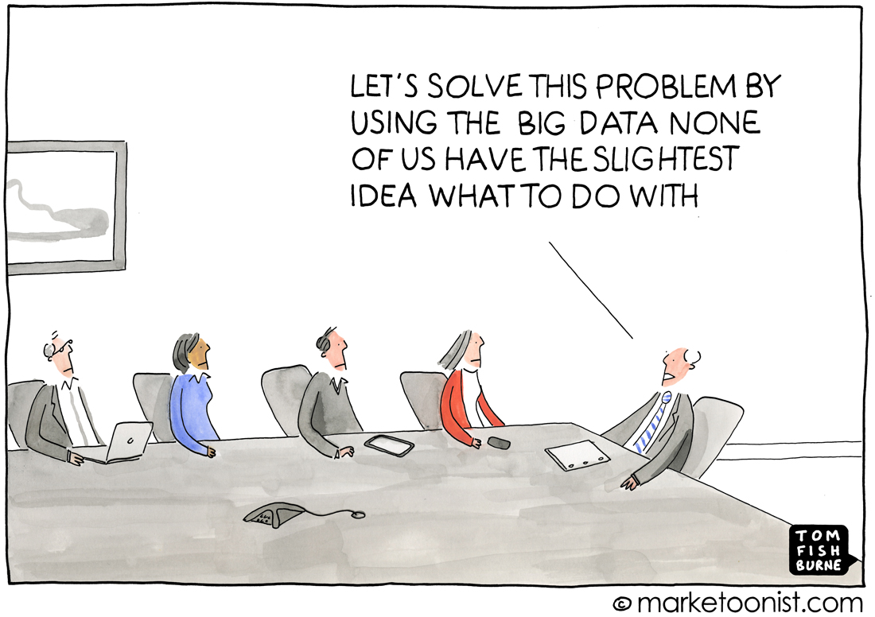

Slide 3
Outline
Background: Research in a time of Big Data
Challenges for data analysis
Part 1: Sparse Common Components
Part 2: Sparse Principal Covariates Regression
Illustrations
  Exploration: 500 families
  Prediction: Systems vaccinology
Discussion

Slide 4
Background:
Research in a time of Big Data

Slide 5
Big Data in the Sciences
Everything is measured
  What we think and do: Social media, Web browsing behavior
  Where we are and with whom: Wearables, cameras
  At a very detailed level: DNA, neuron, experience sampling
Data are shared
  Open data: in science, governments (open government data)
Data are linked
  Government
  Science: multi-disciplinary
  Linked Data web-architecture

Slide 6
1 … 500
1
.
.
.
.
.
.
.
.
.
.
.
.
.
.
.
.
10 000
Questionnaire data
Respondents
Well being
Traditional data: Health & Retirement Study

Slide 7
1 … 500
501 … 50 000
1
.
.
.
.
.
1000
Questionnaire
data
Novel kind of data:
DNA, GPS, …
Well being
Respondents
Health & Retirement Study: traditional + novel type of data
  Multiple sources, heterogeneous in nature
  Untargeted
  High-dimensional (p>>n)
Big Data

Slide 8

Illustration: ALSPAC household panel data
  Multiple sources / multi-block (heterogeneous)
  High-dimensional
(epi)-genetic
clinical
respondents
questionnaire

Slide 9

Illustration: ADNI data
  Multi-block data
  (Outcome)
1 … 10
1 … 100
1 … 100000
1
.
.
.
.
.
1000
Clinical
data
Questionnaire data
Cogn.
Fctn
Respondents
Neuro-imaging data

Slide 10
The Promises of linked Traditional with novel data
Extremely information-rich data
  1) Gives insight in the interplay between multiple factors / system or multi-disciplinary point of view (Exploratory; hypothesis generating)
  Eg. gene-environment interactions: Link susceptibility genes with protective/risk-provoking environmental conditions
  2) Adds context, detail => deeper understanding + more accurate prediction
  Eg. Similar income, social network, health but difference in well-being?
However, statistical tools fall short … how to find the linked variables?

Slide 11
Challenges for data analysis

Slide 12

Non-theory driven nature of Big Data
Novel / Big data:
  NOD: Naturally Occurring Data
  High-throughput screening (eg, GWAS)
  => untargeted
  Furthermore, little theory available on these novel sorts of data.
Relevant variables? Introduces a variable selection problem.

Slide 13
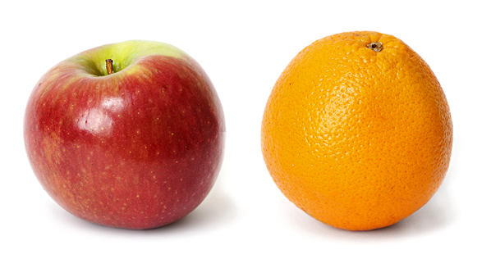
The hidden link
Data from different measurement sources are very different:
  Different sizes of data blocks, different noise/measurement levels
  Stronger correlations of variables within blocks than between blocks, e.g.,
    Psych. Quest.: Eg, response tendencies, general psychological processes
    Transcriptomics: Eg, (general) biological processes
  => Linked variables / shared mechanisms are hidden while block-specific mechanisms dominate

Slide 14
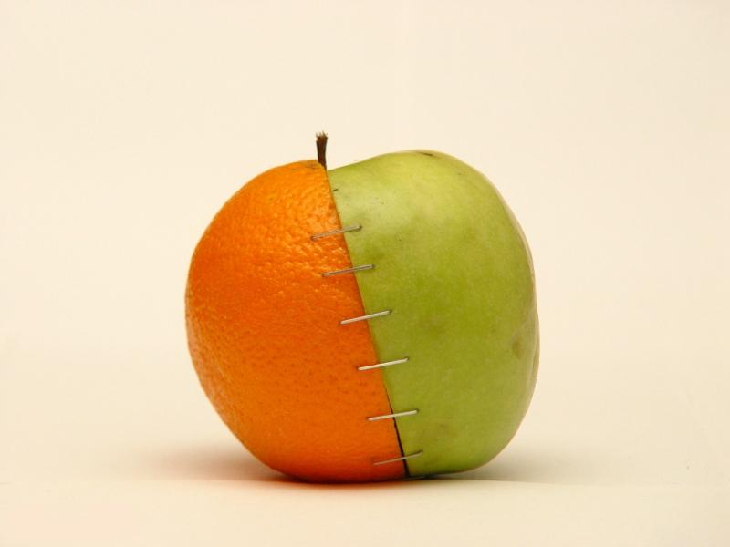

The hidden link
Popular but bad ideas for analysing linked (traditional with) big data:
  1) glueing the data together and analysing them as one block
          2) analysing each block separately and comparing the results

Slide 15
Furthermore …

Slide 16
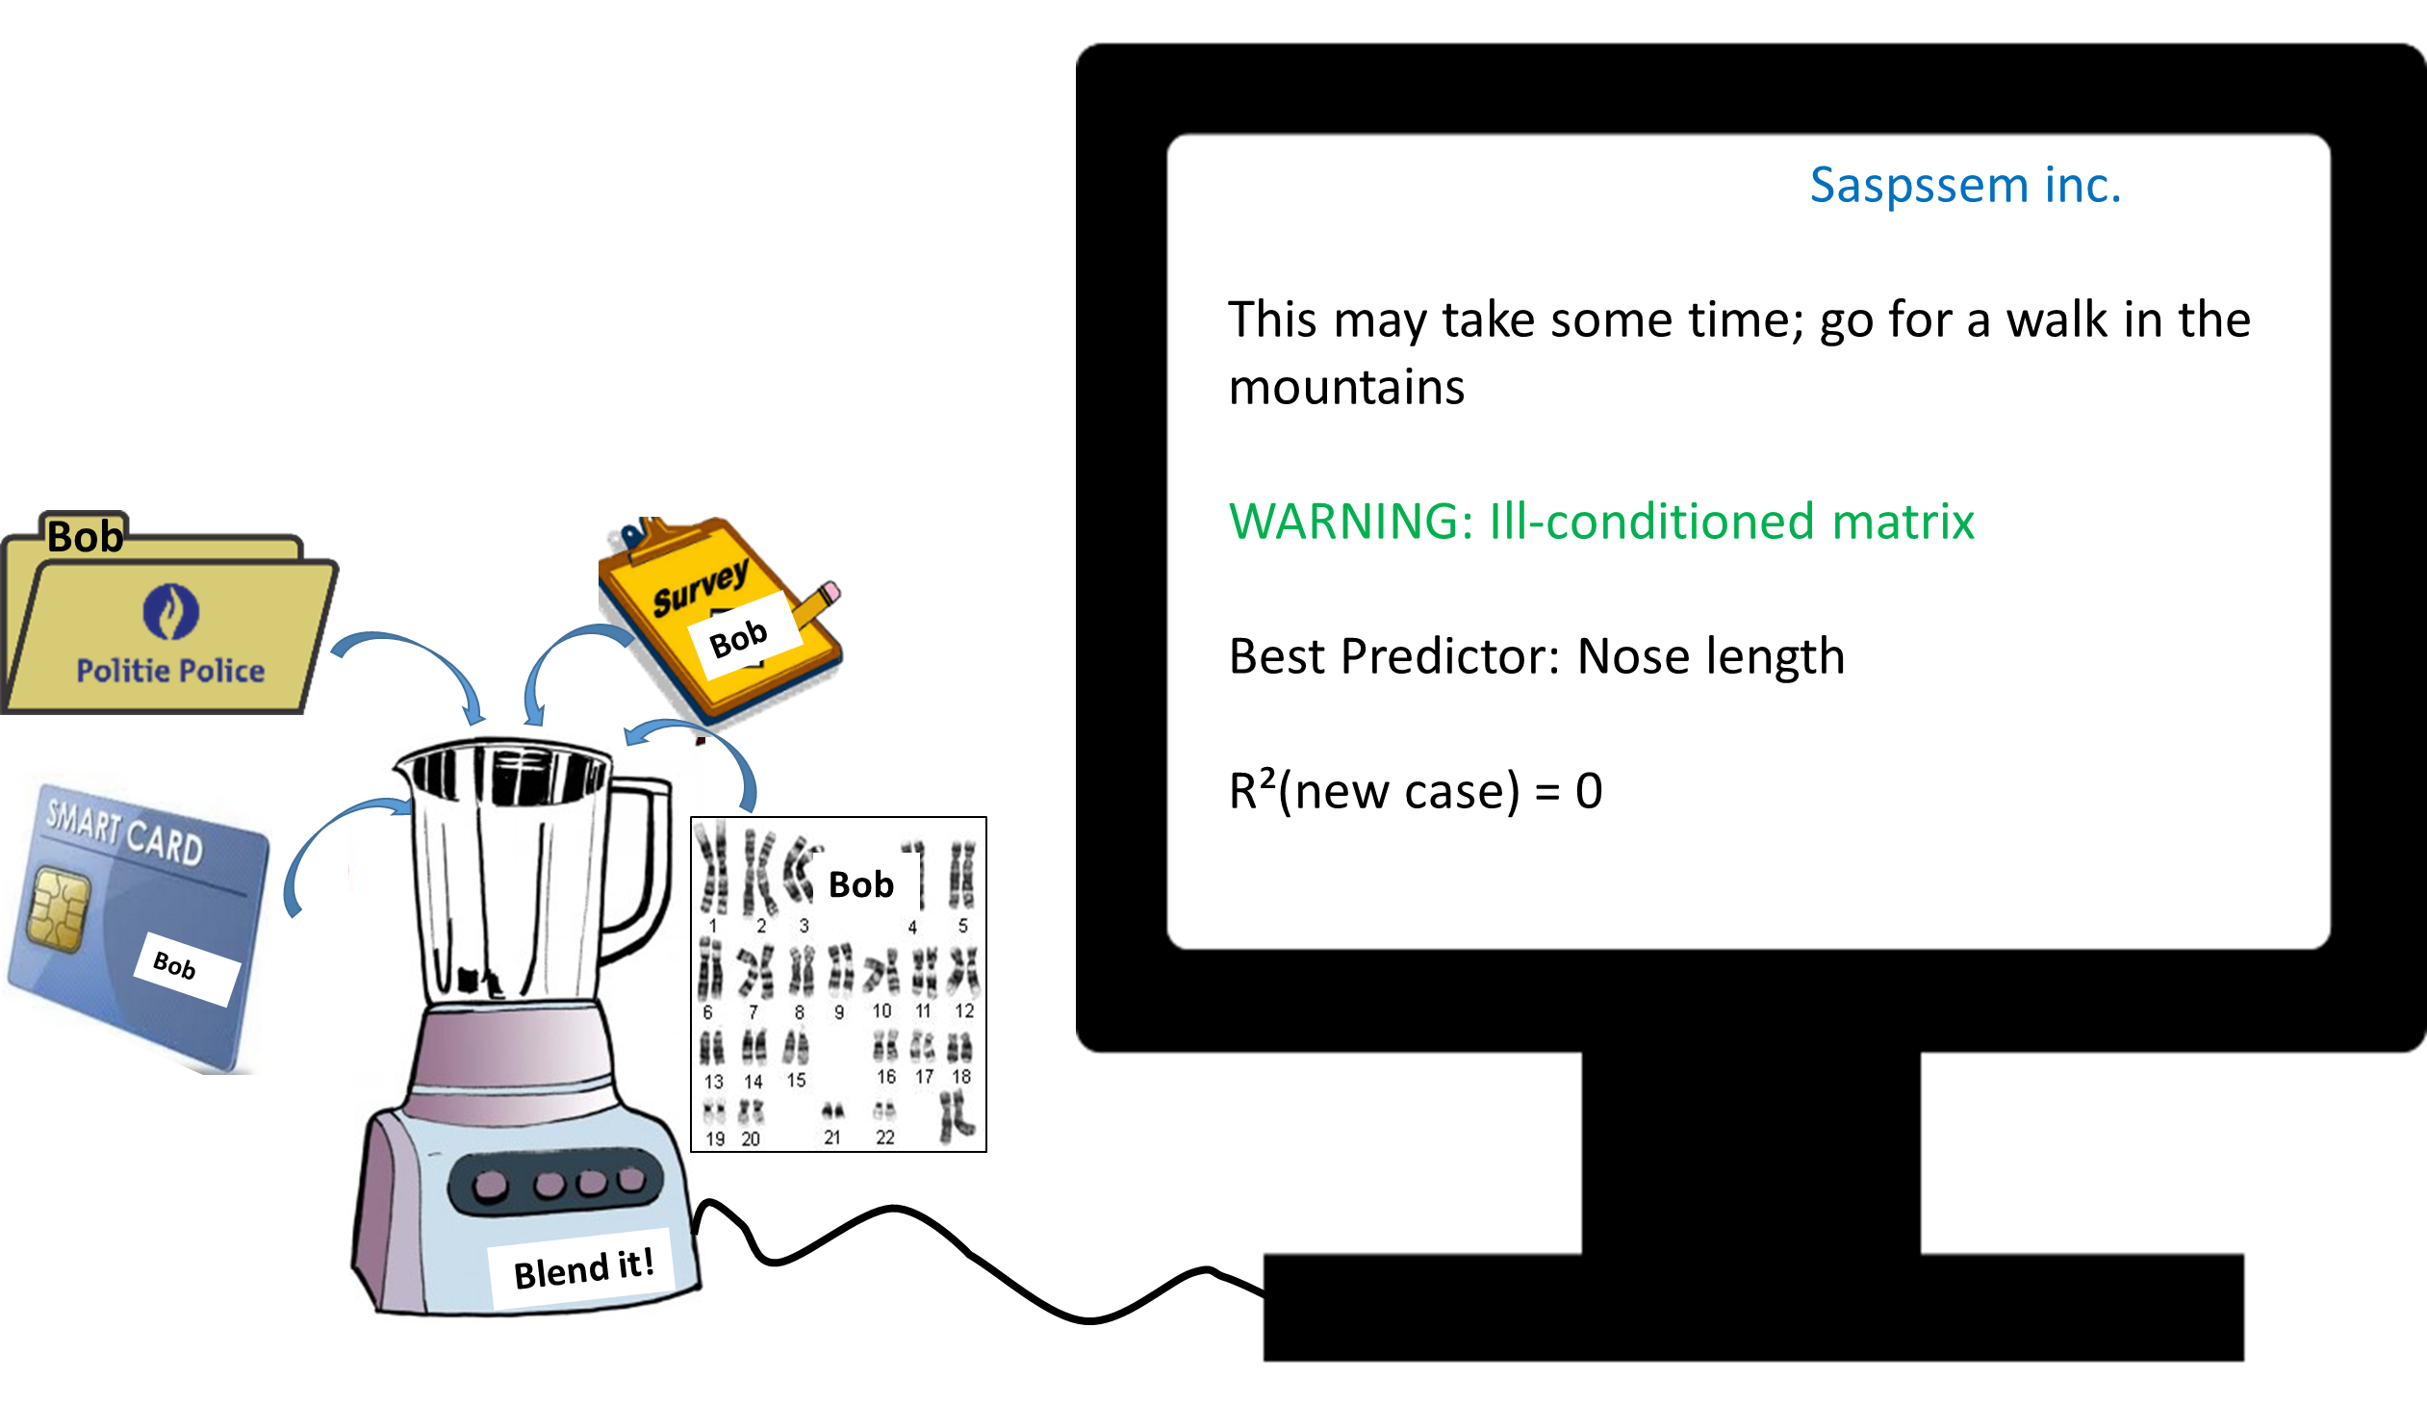

Slide 17
In sum: The challenges
Automated selection of variables needed, in the (ultra-) high-dimensional setting (=many more variables than observations)
Integrative approach: find shared mechanisms, even if hidden / dominated by source-specific sources of variation
Computational efficiency (time + memory)

Slide 18
PART I:
Sparse Common Components

Slide 19
Revealing the linked variables
Questionnaire data
Genetic data
1 … 500
501 … 50 000
1
.
.
.
.
.
1000
Respondents
Gene-environment interaction

Slide 20
Notation and naming conventions
  data block: denotes the different data sources forming the multiblock data
  X_{k} : data block k (with k=1,…,K )
  Each of the data blocks: same set of observation units (respondents)
1 … 500
501 … 50 000
1
.
.
.
.
.
1000
X₁: Questionnaire
data
Respondents
X₂: Genetics data

Slide 21
Solving the challenges
Exploratory approach needed
Find structural sources of variation / shared mechanisms
  Usual suspect: Principal component analysis
  Proposed Sparse Common Component method is an extension of PCA

Slide 22
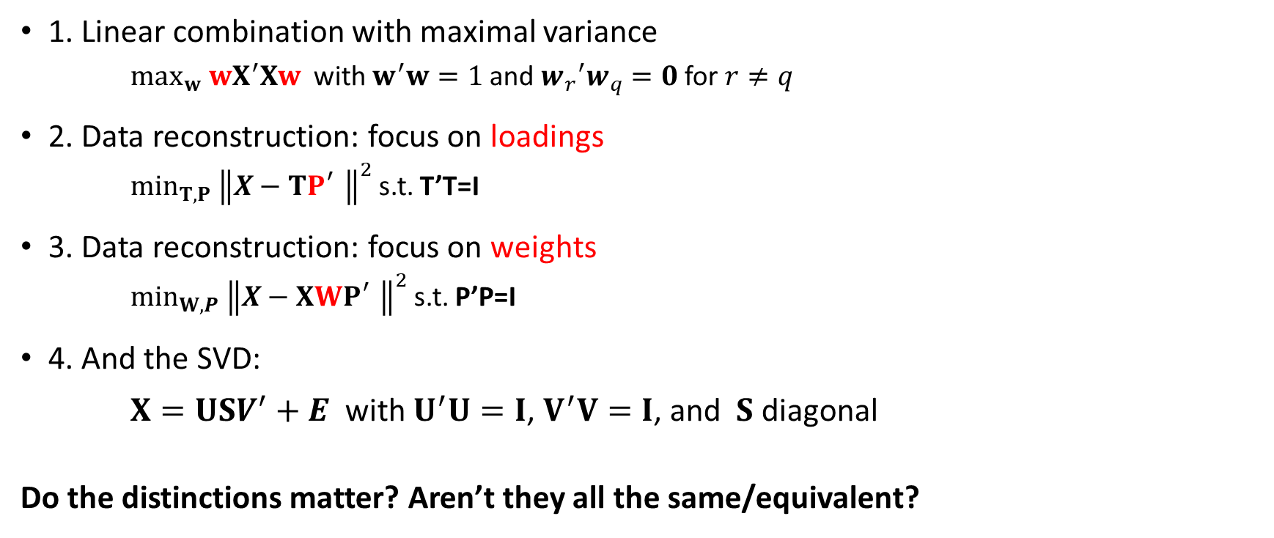
The many faces of PCA
1. Linear combination with maximal variance
  $\max_{w} wX^{′}Xw$ with $w^{′}w=1$ and ${w_{r}}^{′}w_{q}=0$ for $r≠q$
2. Data reconstruction: focus on loadings
  ${\min_{T,P} \left\|X−TP_{}^{′}\right\|}^{2}$ s.t. T’T=I
3. Data reconstruction: focus on weights
  ${\min_{W,P} \left\|X−XWP_{}^{′}\right\|}^{2}$ s.t. P’P=I
4. And the SVD:
$X=USV^{′}+E$ with $U^{′}U=I$, $V^{′}V=I$, and $S$ diagonal
Do the distinctions matter? Aren’t they all the same/equivalent?

Slide 23
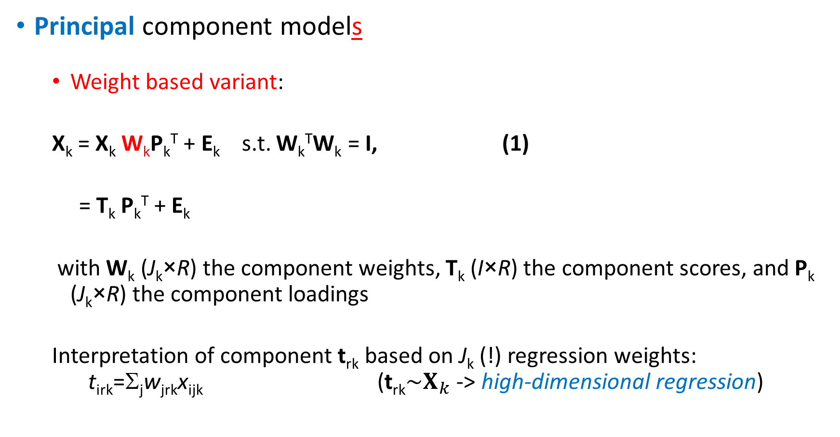
PCA
Principal component models
  Weight based variant:
  X_{k} = X_{k} W_{k}P_{k}^{T} + E_{k} s.t. W_{k}^{T}W_{k} = I, (1)
  = T_{k} P_{k}^{T} + E_{k}
  with W_{k} (J_{k}×R) the component weights, T_{k} (I×R) the component scores, and P_{k} (J_{k}×R) the component loadings
  Interpretation of component t_{rk} based on J_{k} (!) regression weights: t_{irk}=Σ_{j}w_{jrk}x_{ijk} ($\text{t}\text{r}\text{k}\sim X_{k}$ -> high-dimensional regression)
SCA
CCA
SCCA

Slide 24
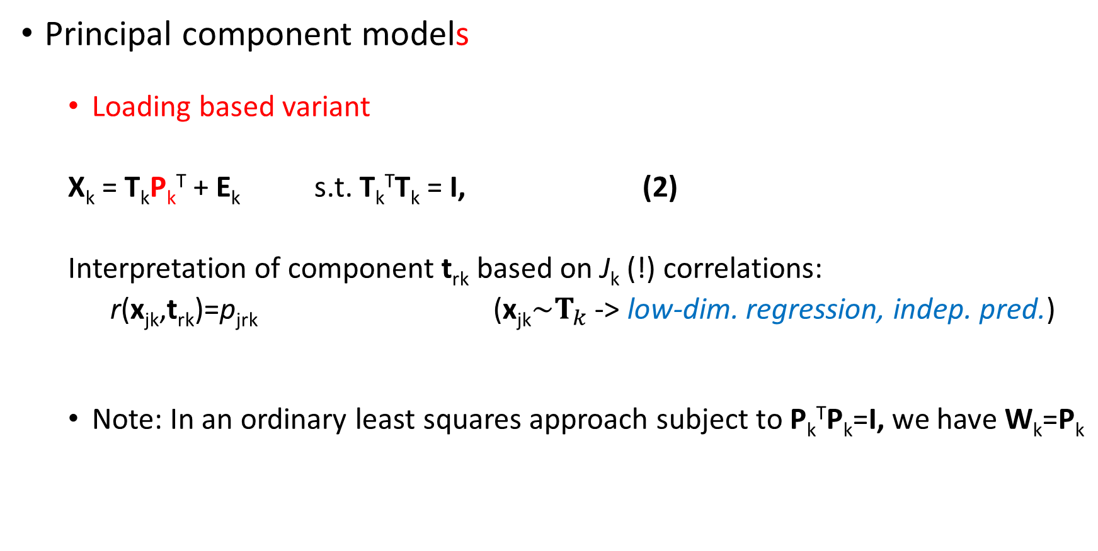
PCA
SCA
Principal component models
  Loading based variant
  X_{k} = T_{k}P_{k}^{T} + E_{k} s.t. T_{k}^{T}T_{k} = I, (2)
  Interpretation of component t_{rk} based on J_{k} (!) correlations:
  r(x_{jk},t_{rk})=p_{jrk} ($\text{x}\text{jk}\sim T_{k}$ -> low-dim. regression, indep. pred.)
  Note: In an ordinary least squares approach subject to P_{k}^{T}P_{k}=I, we have W_{k}=P_{k}
CCA
SCCA
Notes:
24

Slide 25
Simultaneous component analysis
  For all k:
  X_{k} = TP_{k}^{T} + E_{k} s.t. T^{T}T=I (3)
  -> same component scores for all data blocks!
  1. Weight based variant:
  [X₁ ... X_{K}] = T [P₁^{T} ... P_{K}^{T}] + [E₁ ... E_{K}^{T}]
  = [X₁ ... X_{K}] [W₁^{T} ... W_{K}^{T}]^{T} [P₁^{T} ... P_{K}^{T}] + [E₁ ... E_{K}^{T}]
  2. Loading based variant:
  X_{conc} = T P_{conc}^{T} + E_{conc} (4)
PCA
SCA
CCA
SCCA
Notes:
25

Slide 26
Simultaneous components
  Model the largest source of variation in the concatenated data, often this is source-specific variation or a mix of common and specific variation
  Guarantee same source of variation for the different data blocks
  But … do not guarantee that the components are common!
    See also Schouteden et al. (BRM, 2013): Rotation to common & specific components
PCA
SCA
CCA
SCCA

Slide 27
PCA
Common component analysis (CoCo)
  Account for dominating source specific variation
  Common component model:
X_{k} = TP_{k}’ such that T’T=I and P_{k} has common / specific structure
  Structure can be imposed (constrained analysis, if K small / structure known)
  Or: X_{k}= X_{conc}W_{conc}P_{k}’ with the W_{conc} having common / specific structure
SCA
CCA
SCCA
 | P1 |  |  | P2
Common | x | x | x | x | x | x | x
Spec1 | x | x | x | 0 | 0 | 0 | 0
Spec2 | 0 | 0 | 0 | x | x | x | x

Slide 28
So far, so good …
Yet:
  Interest in relevant / important variables (genetic markers, social factors)?
  Interpretation of the components based on 1000s of loadings/weights is infeasible
  PCA estimates are not consistent in case of high-dimensional data (Johnstone & Lu)
Need to automatically select the “relevant” variables!
Sparse common components are needed.

Slide 29
PCA
Structured sparsity:
  Sparse common components: few non-zero loadings in each data block X_{k}
  (Sparse) specific components: (few) non-zero loadings only in one/few data blocks X_{k}
SCA
CCA
SCCA
 | X1 |  |  | X2
Common | x | 0 | 0 | x | x | 0 | x
Spec1 | x | x | x | 0 | 0 | 0 | 0
Spec2 | 0 | 0 | 0 | x | 0 | x | x

Slide 30
Variable selection: How to?
Sparse analysis
  Impose restriction on the loadings/weights: many should become zero
  S-O-A: add penalties (e.g., lasso) to the objective function

Slide 31
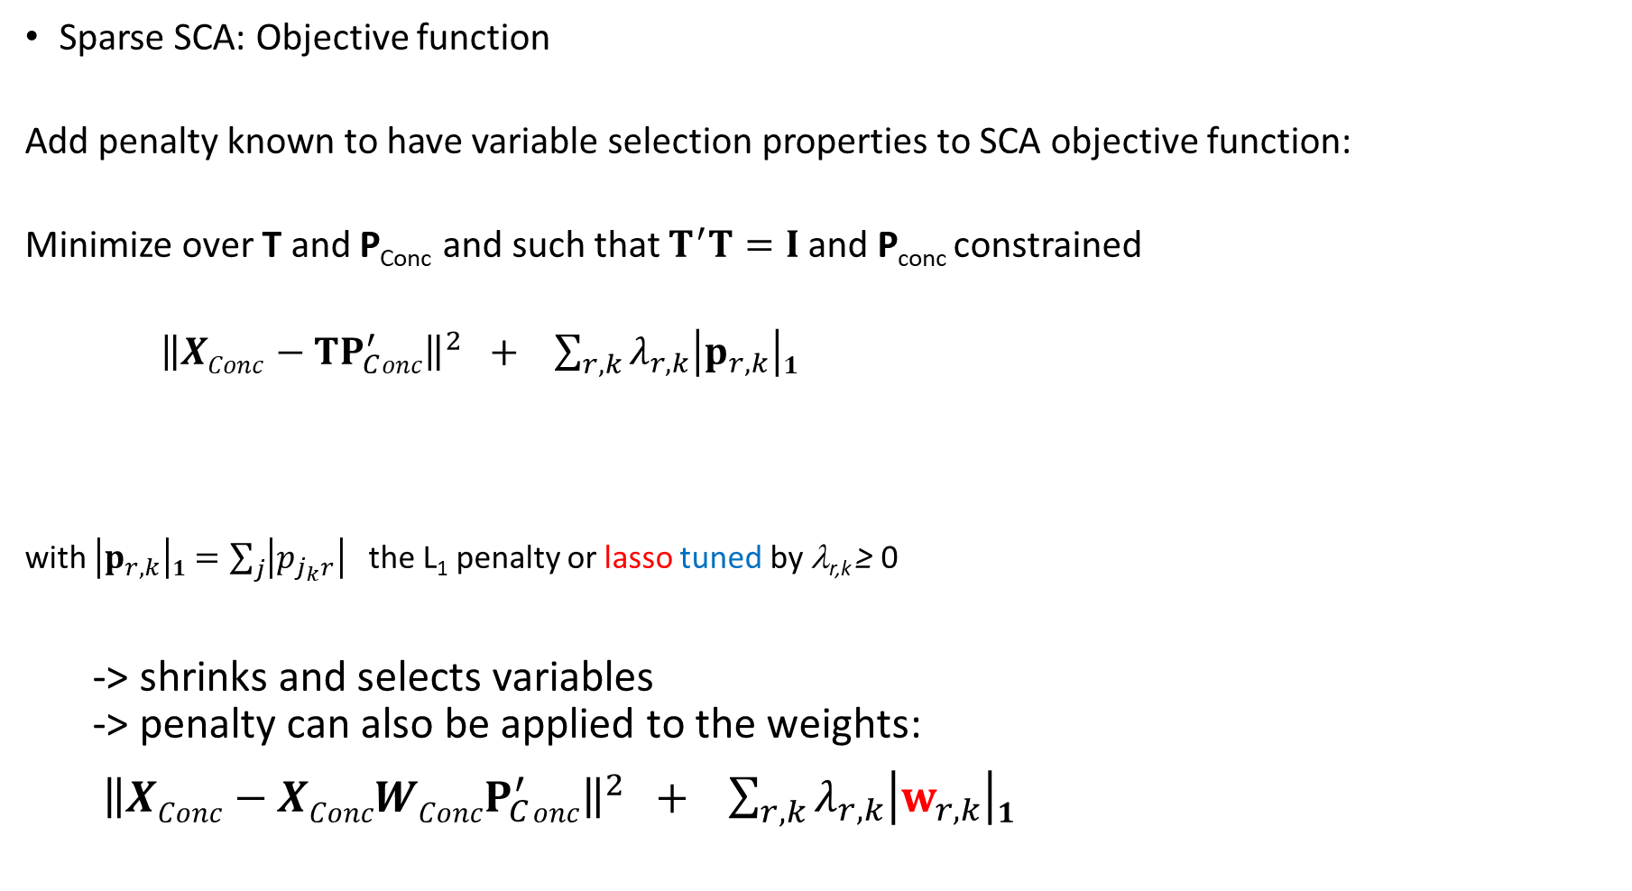
Sparse SCA: Objective function
Add penalty known to have variable selection properties to SCA objective function:
Minimize over T and P_{Conc} and such that $T^{′}T=I$ and P_{conc} constrained
${\left\|XConc−TP_{C}^{′}onc\right\|}^{2} + \sum_{r,k}{λ_{r,k}\left|p_{r,k}\right|1}$
with $\left|p_{r,k}\right|1=\sum_{j}{\left|p_{j_{k}r}\right|}$ the L₁ penalty or lasso tuned by λ_{r,k} ≥ 0
  -> shrinks and selects variables
  -> penalty can also be applied to the weights:
  ${\left\|XConc−XConcWConcP_{C}^{′}onc\right\|}^{2} + \sum_{r,k}{λ_{r,k}\left|w_{r,k}\right|1}$
Fit / SCA
Penalty

Slide 32
In-house Algorithm: Alternating procedure
Given fixed tuning parameters and number of common and distinctive components, do
0. Initialize P_{conc}
1. Update T conditional upon P_{conc}
Closed form: T=UV’ with U and V from the SVD of X_{C}P (I×R -> small for H-D data)
2. Update P_{conc} conditional upon T
Univariate soft thresholding (see next)
3. Check stop criteria (convergence of the loss, maximum number of iterations) and return to step 1 or terminate

Slide 33

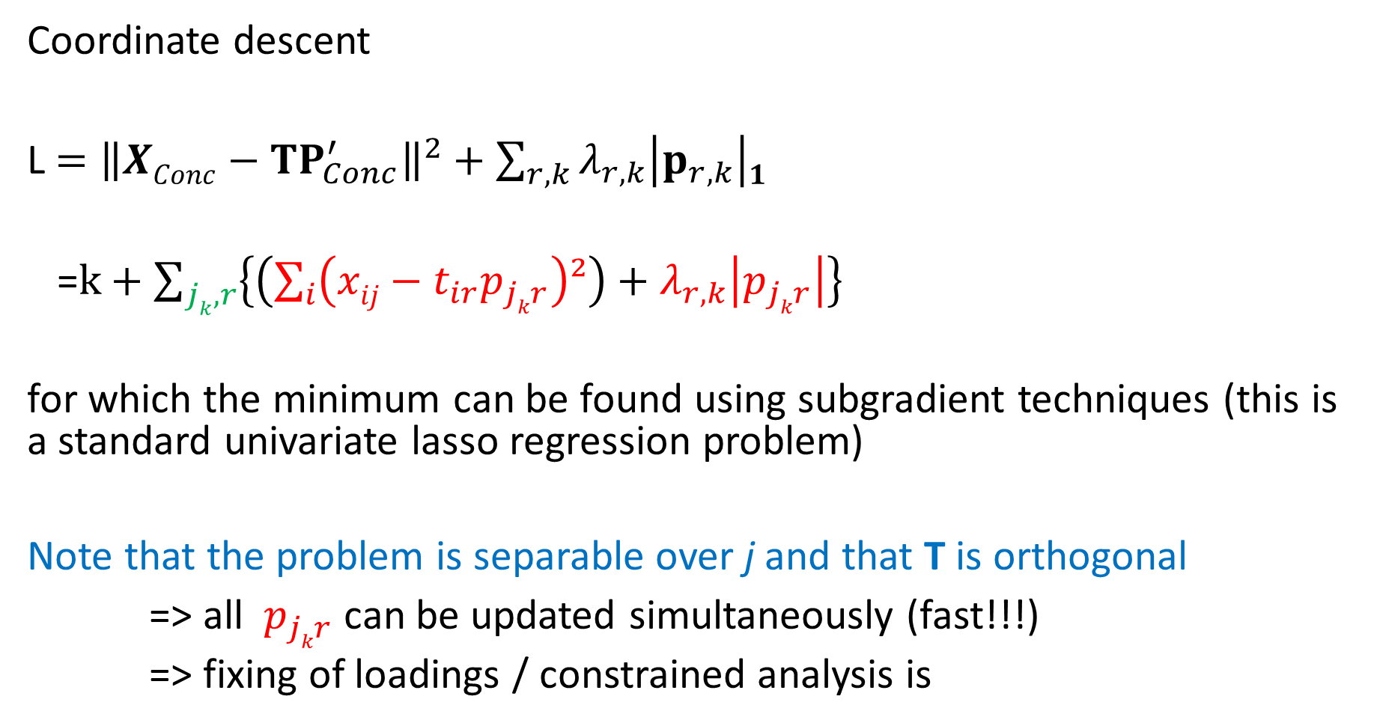
Coordinate descent
L $={\left\|XConc−TP_{Conc}^{′}\right\|}^{2}+\sum_{r,k}{λ_{r,k}\left|p_{r,k}\right|1}$
=$k+\sum_{jk,r}{\left\{\left(\sum_{i}{\left(xij−t_{ir}p_{jkr}\right)²}\right)+λ_{r,k}\left|p_{jkr}\right|\right\}}$
for which the minimum can be found using subgradient techniques (this is a standard univariate lasso regression problem)
Note that the problem is separable over j and that T is orthogonal
=> all $p_{jkr}$ can be updated simultaneously (fast!!!)
=> fixing of loadings / constrained analysis is
Notes:
D: not same as D1 to account for component specific value of the penalty tuning parameter

Slide 34
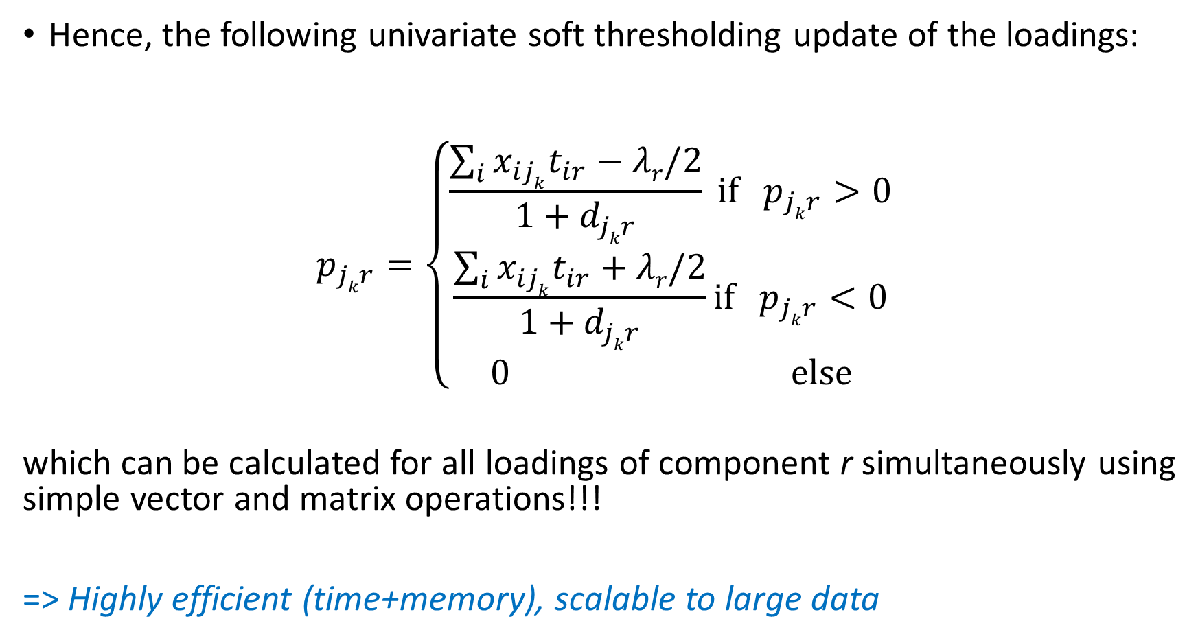
Hence, the following univariate soft thresholding update of the loadings:
$$p_{jkr}=\left\{\begin{matrix}\frac{\sum_{i}{x_{ijk}t_{ir}−λr/2}}{{1+d}_{jkr}} \text{i}\text{f}{ p}_{jkr}>0 \\ \frac{\sum_{i}{x_{ijk}t_{ir}+λr/2}}{{1+d}_{jkr}}\text{i}\text{f}{ p}_{jkr}<0 \\ 0 \text{else}\end{matrix}\right.$$
which can be calculated for all loadings of component r simultaneously using simple vector and matrix operations!!!
=> Highly efficient (time+memory), scalable to large data

Slide 35

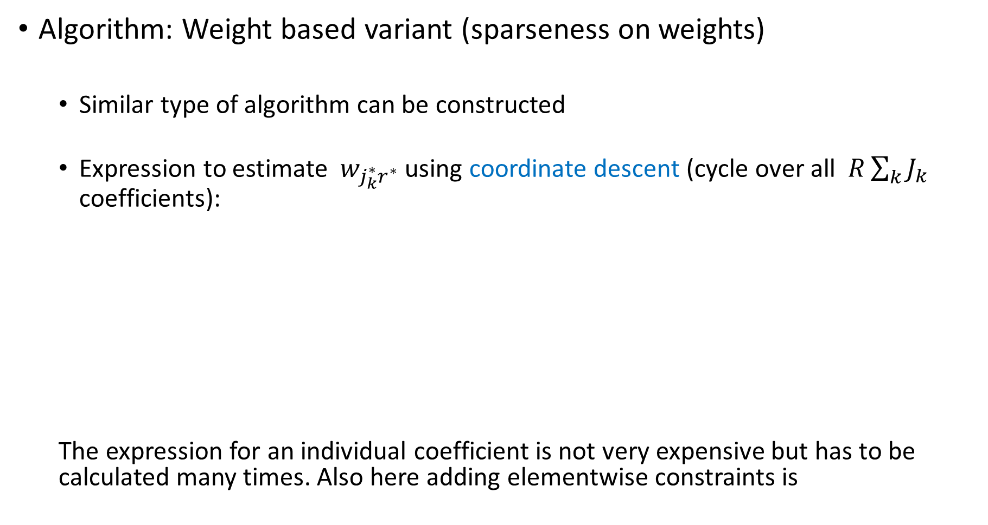
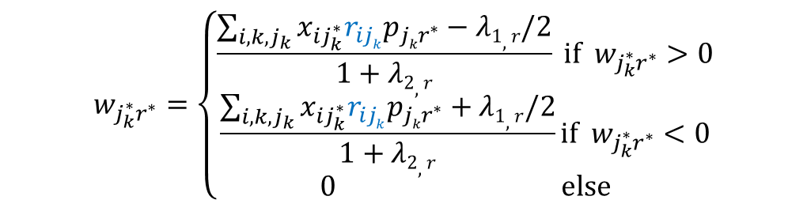
Algorithm: Weight based variant (sparseness on weights)
  Similar type of algorithm can be constructed
  Expression to estimate $w_{j_{k}^{∗}r^{∗}}$ using coordinate descent (cycle over all $R\sum_{k}{J_{k}}$ coefficients):
  The expression for an individual coefficient is not very expensive but has to be calculated many times. Also here adding elementwise constraints is
$$w_{j_{k}^{∗}r^{∗}}=\left\{\begin{matrix}\frac{\sum_{i,k,j_{k}}{x_{ij_{k}^{∗}}r_{ijk}p_{{jkr}^{∗}}−λ1,r/2}}{1+λ2,r} \text{i}\text{f} w_{j_{k}^{∗}r^{∗}}>0 \\ \frac{\sum_{i,k,j_{k}}{x_{ij_{k}^{∗}}r_{ijk}p_{{jkr}^{∗}}+λ1,r/2}}{1+λ2,r}\text{i}\text{f} w_{j_{k}^{∗}r^{∗}}<0 \\ 0 \text{else}\end{matrix}\right.$$
Ridge penalty has to be included

Slide 36
Algorithm
  Coordinate-wise approach allows to fix coefficients: Can be used to define the specific components by fixing to zero those coefficients corresponding to the block(s) that is not accounted for by the component
  Often no prior knowledge on number of specific components; for which block(s) they are specific => we also included a group lasso penalty (performs automated selection at the block level)
  Is run with input of the nr of components; their status (common/specific) and/or values for the (group) lasso tuning parameter => MODEL SELECTION; good results for Index of Sparseness, not for (repeated) double CV
Gu & Van Deun (2019)

Slide 37
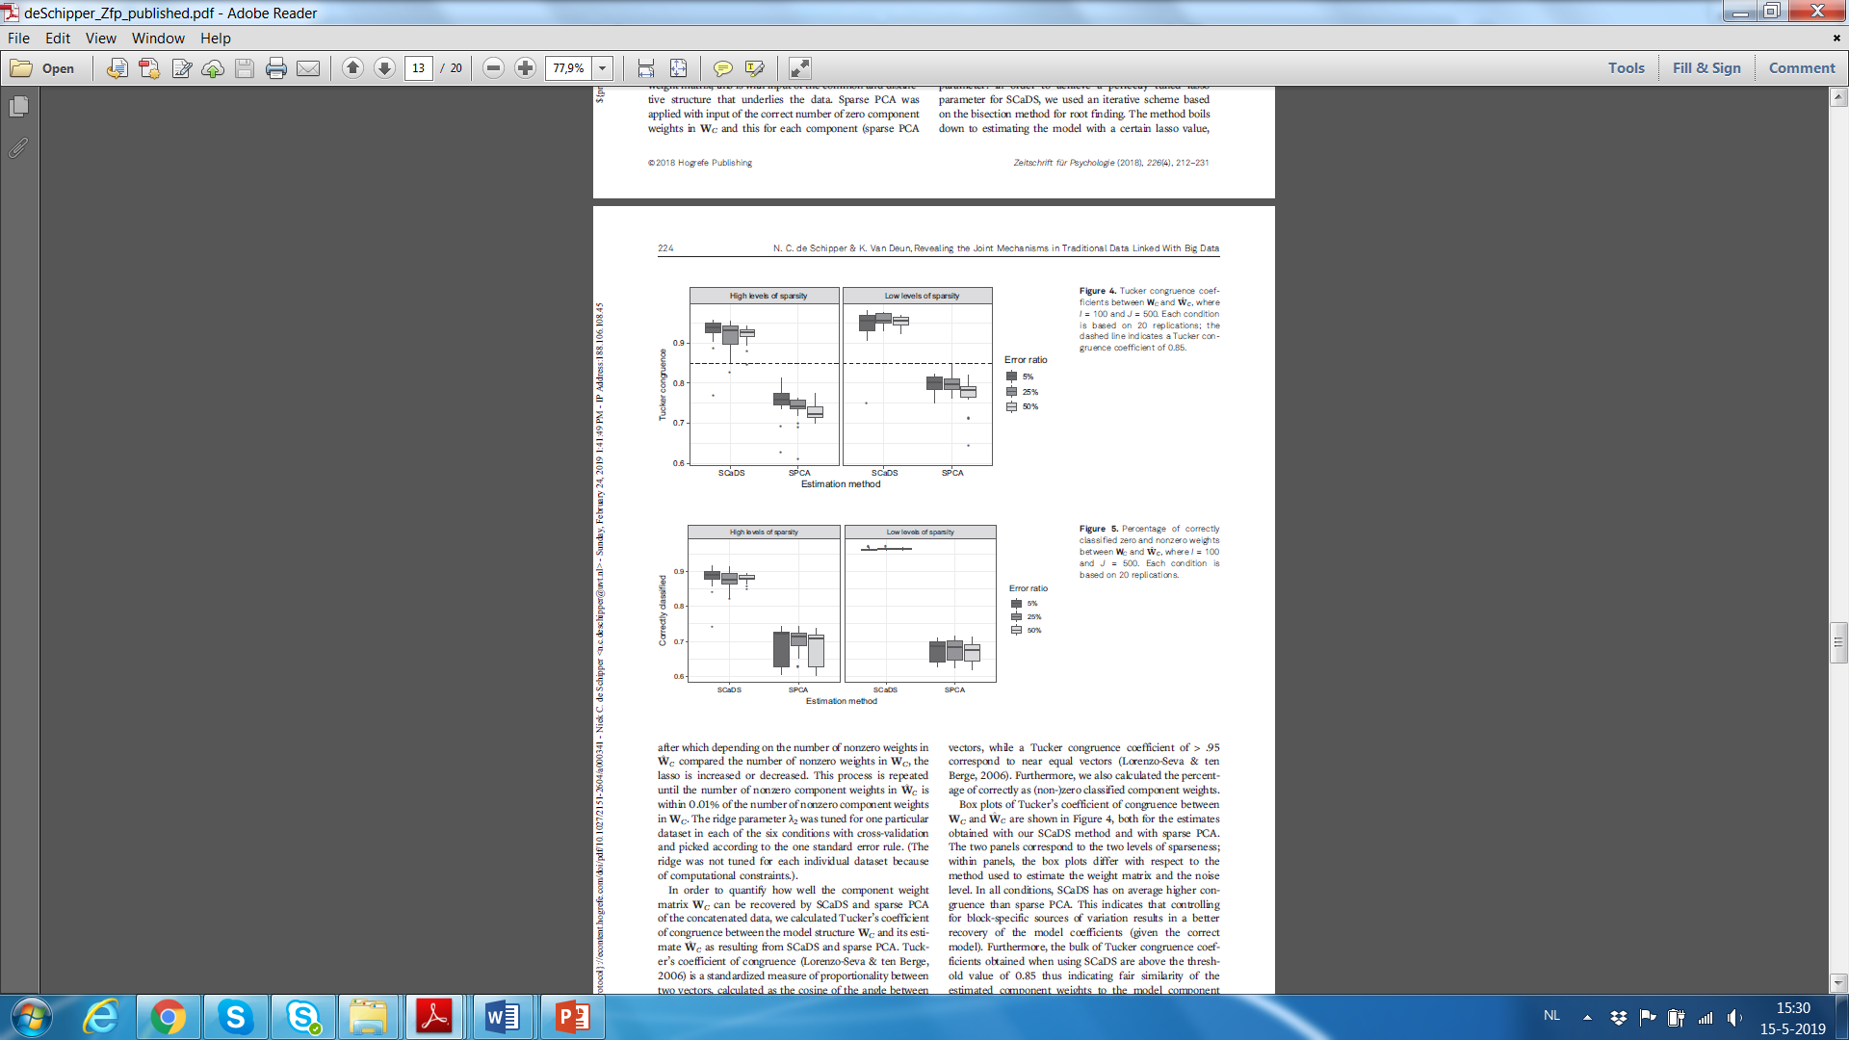
Comparison with sparse PCA (Zou et al., 2005): Simulated data
Zero/non-zero recovery
Tucker congruence
de Schipper & Van Deun (2018)

Slide 38
Some illustrations

Slide 39

500 Family Study (Schneider & Linda, 2008)
Three data blocks: 195 families
  Father -> 8 variables
  Mother -> 8 variables
  Child -> 7 variables
Analyzed with the RegularizedSCA package (available from CRAN)
  This is the sparse loading variant
  Several options for model selection; includes the DISCO rotation
Exploratory analysis
Gu & Van Deun (2018)

Slide 40
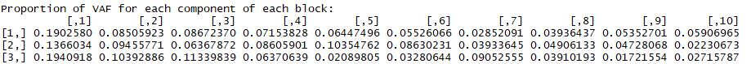
Model Selection
  Step 1: VAF method => 5 components
  Step 2: tuning of lasso and group lasso penalties using index of sparseness => 2 mother, 1 father, 1 parent, and 1 child component

Slide 41
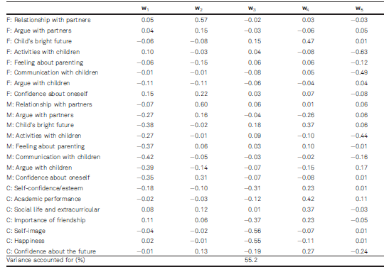
Traditional analysis

Slide 42
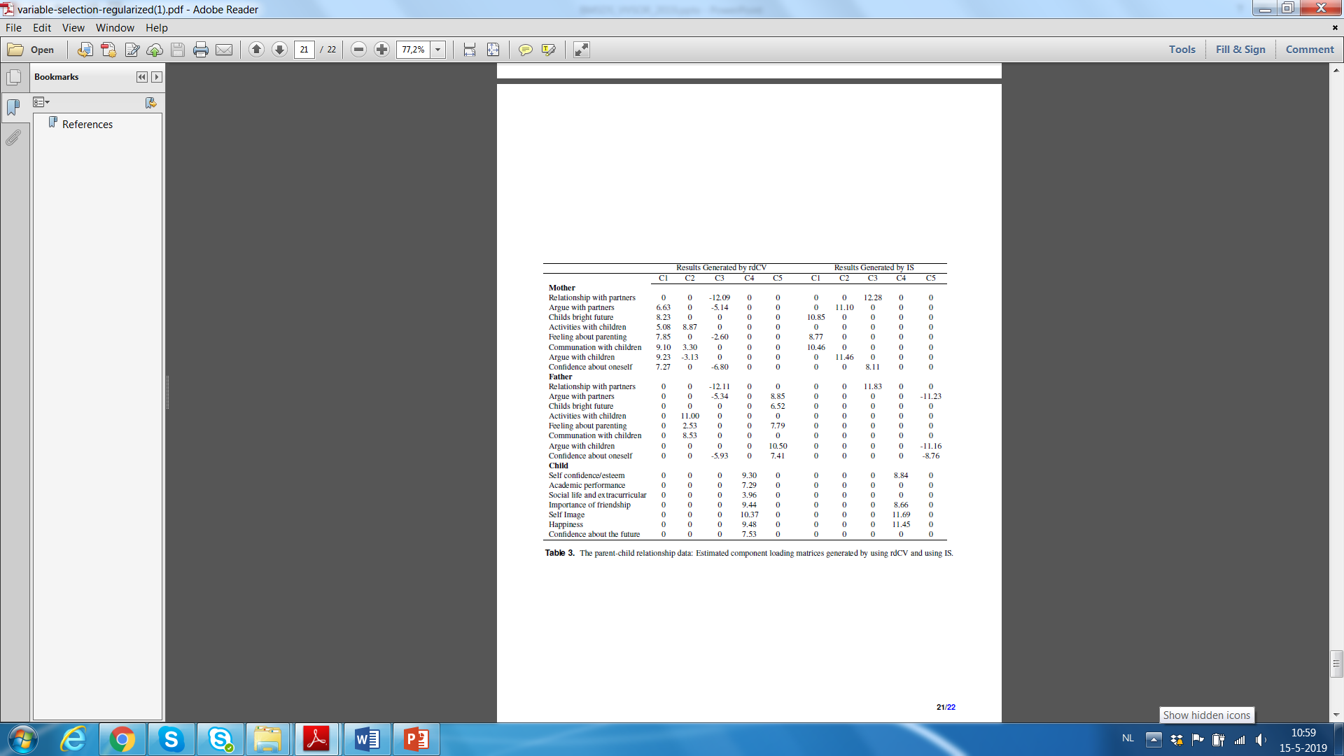
C1+C2: Mother specific
C3: partner relation
C4: Child’s wellbeing
C5: partner
! No common component; child’s feelings are independent from parental behavior!

Slide 43
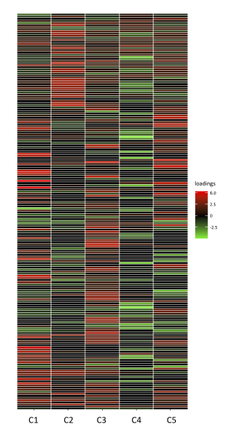
Metabolomics Illustration:
2 Blocks of data: GC-MS + LC-MS
IS suggests 5 sparse common components

Slide 44
PART 2:
Insightful Prediction in a high-dimensional context

Slide 45
Illustration: An insightful linear model for high-dimensional prediction
Motivating example: Systems vaccinology (Nakaya et al., 2011)
transcript₅₄₇₁₅
transcript₂
transcript_{g}
titer
transcript₁
. . .
. . .
1
1
.
.
.
.
.
26
2
.
.
.
X
y
i
.
.
.
26

Slide 46

Sparse Principal Covariates Regression
Extension of PCovR (de Jong & Kiers, 1992)
Simultaneous sparse PCA and regression
W sparse
    X = XWP_{x}^{T}+E_{x}
    = TP_{x}^{T}+E_{x} s.t. T^{T}T=I
    y = XWp_{y}+E_{y}
    = Tp_{y}+E_{y} s.t. T^{T}T=I
w
0
0
w
0
w
w
0
0
0
w
0
0
0
w
0
0
w
0
w
w
0
0
0
0
0
0
1 . . . . . . . . . . . . . . . . . . . . . . J
1
.
i
.
I
1
r
R
P_{X}^{T}
y
T
p_{y}
X
≈
T
≈
1 . . . . . . . j . . . . . . . . J
1 . . . . . . . j . . . . . . . . J
1 . r . R
1 . r . R
1 . . . . . . R

Slide 47
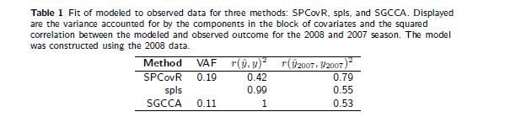
Systems vaccinology example: Comparison of results with sparse PLS
Compare with $r\left({\hat{y}}_{2007},y_{2007}\right)²$ = 0,06 for elastic net
(200 non-zero regression weights, tuned with CV using glmnet)
Van Deun, Crompvoets, & Ceulemans (2018)

Slide 48
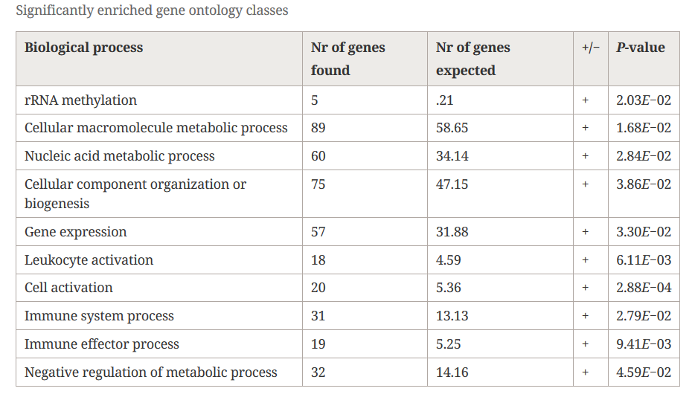
SPCovR: Biological content of selected transcripts
Sparse PLS: no (significant) terms found
PC1
PC2

Slide 49
DISCUSSION

Slide 50
We presented a method for finding the linked variables in traditional with novel (Big) data
The method is a generalization of sparse PCA to the multiblock case
  Sparsity can be imposed accounting for the block structure
  Sparsity can be imposed either on the weights or the loadings
  Several (combinations of) penalties possible: ridge, lasso, group lasso, elitist lasso
=> Flexible modeling framework that includes several known methods as special cases: E.g., SPC (Witten et al., 2011); SPCA (Zou et al., 2006); sPCA-rSVD (Shen & Huang, 2007); SCA (Escofier & Pagès, 1983); and PCA

Slide 51
We also presented a method for simultaneous prediction and explanation:
  Extension of PCovR to the high-dimensional setting
  Balances prediction with interpretation and –in a sense – presents the best of two worlds (machine learning and psychometrics)
  Gave promising results on worst-case definion of Big Data for the statistician (this is, (ultra-)high-dimensional)

Slide 52
In progress
  Extension of sparse PCovR to the setting of multiblock data: prediction based on sparse common components
  Development of more stable sparse weights approach

Slide 53

Much to learn, we still have

Slide 54

Thank you!
&

Slide 55
Software:
  RegularizedSCA package available from CRAN
  Sparse Principal Covariates regression available from GitHub:
  https://github.com/katrijnvandeun/SPCovR
References:
  de Schipper, N. & Van Deun, K. (2018). Revealing the joint mechanisms in traditional data linked with Big Data. Zeitschrift fur Psychologie.
  Gu, Z., & Van Deun, K. (2018). RegularizedSCA: Regularized simultaneous component based data integration. Multivariate Behavioral Research.
  Gu, Z., & Van Deun, K. (2019). Variable selection in RegularizedSCA. Under revision for Scientific Reports.
  Van Deun, K., Crompvoets, E.A.V., & Ceulemans, E. (2018). Obtaining insights from high-dimensional data: Sparse principal covariates regression. BMC Bioinformatics, 19:104.

