Slide 1
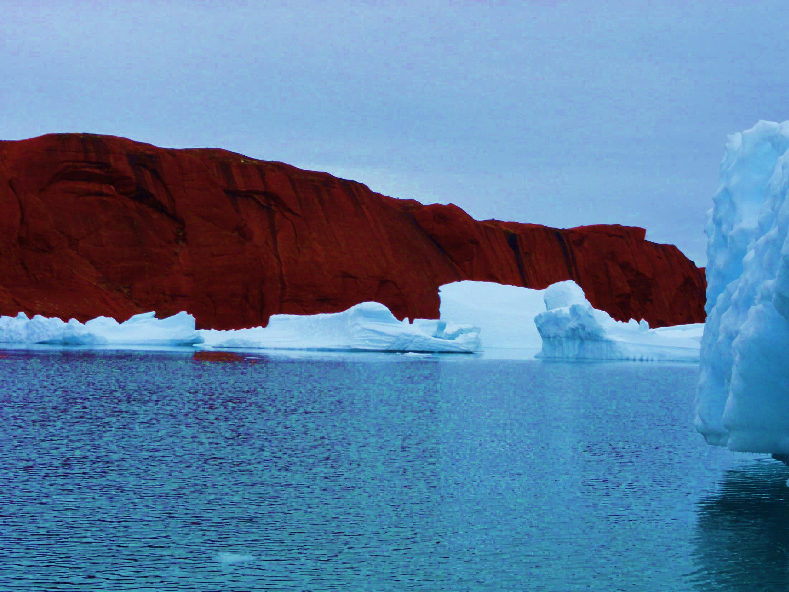
Time scales and time series in climate science
Salomon Kroonenberg

Slide 2
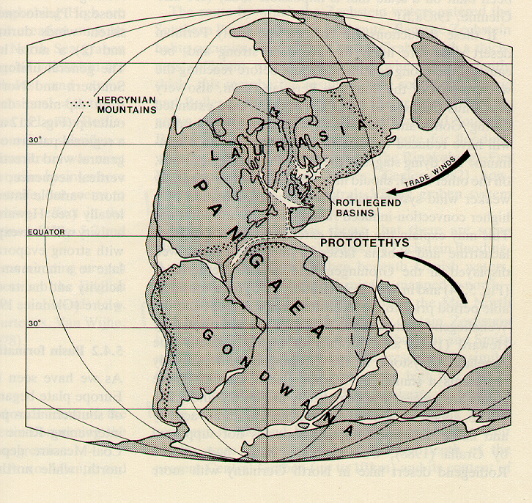
Permian, 250 million years ago
Greenland at Saharan latitude, 3000 km from the ocean like Gobi now, extreme desert climate

Slide 3
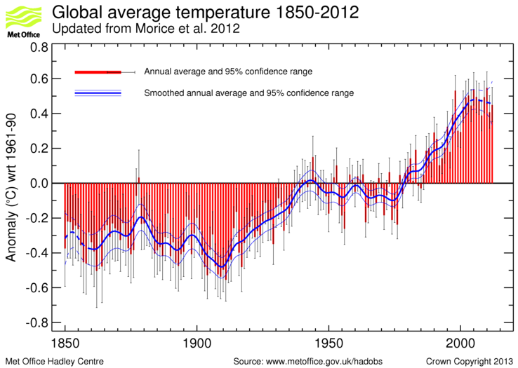
Climate: average of weather over a long period
International Meteorological Organisation
in 1935 (climate was still considered constant):
Period 1901-1930 is Climatic Normal Period
1930
Present-day global temperature data from that period (MetOffice)

Slide 4
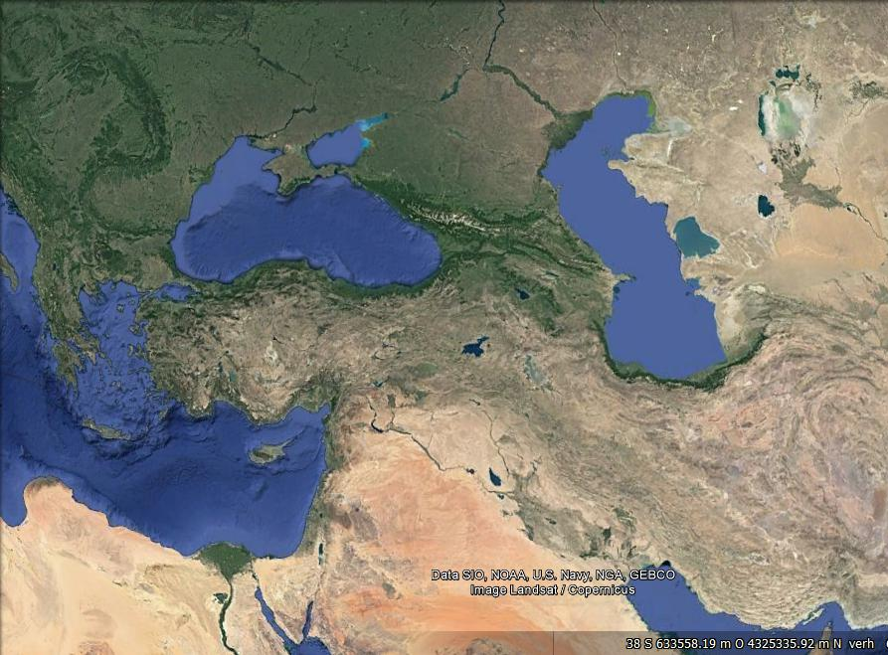
Volga
Aral Sea
Black Sea
Caspian Sea
Mediterranean

Slide 5
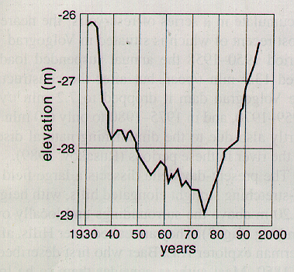
1993: Alarming Caspian Sea Level rise, 15 cm/year, 100* eustatic rate

Slide 6
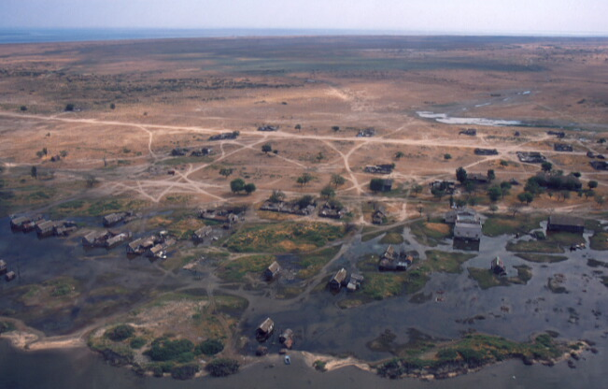
Flooding of Chechen Island, Dagestan. 1995

Slide 7
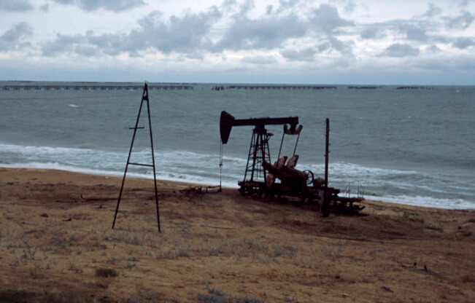
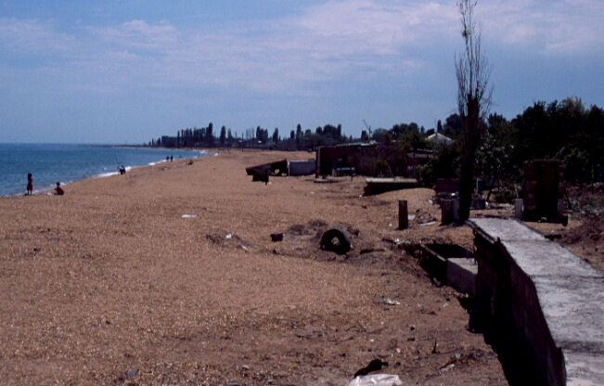
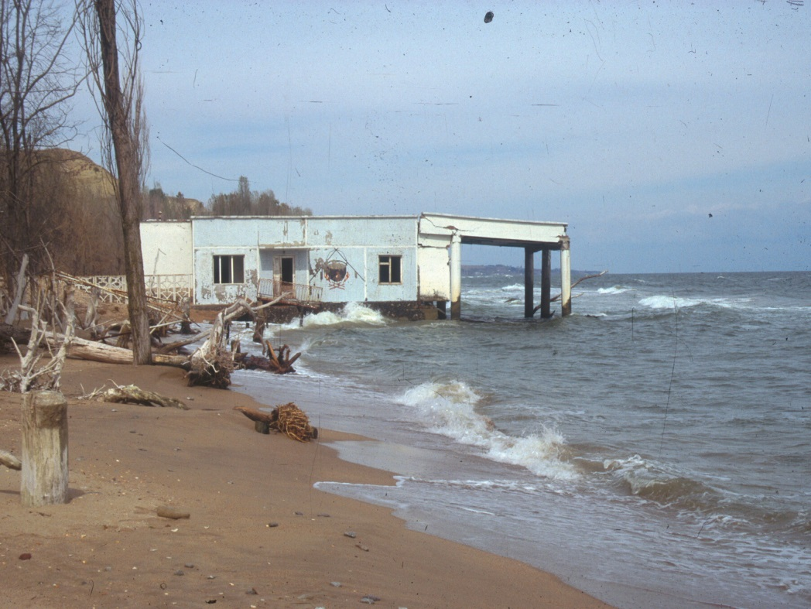
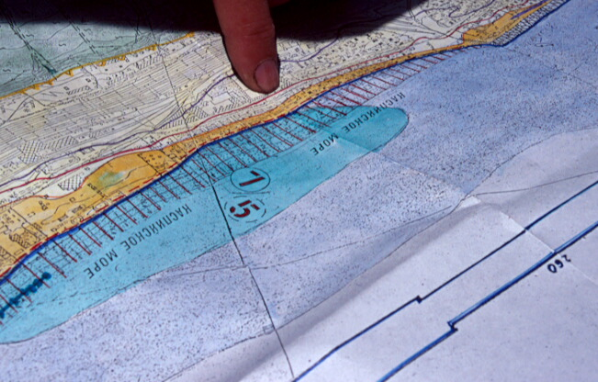
Izberbash, Dagestan, 1995
Kolchoz Karla Marksa, Dagestan, 1995
Manas, Dagestan, 1995

Slide 8
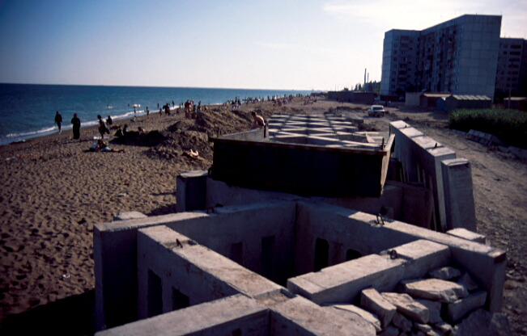
Kaspiisk, Dagestan, 1995

Slide 9
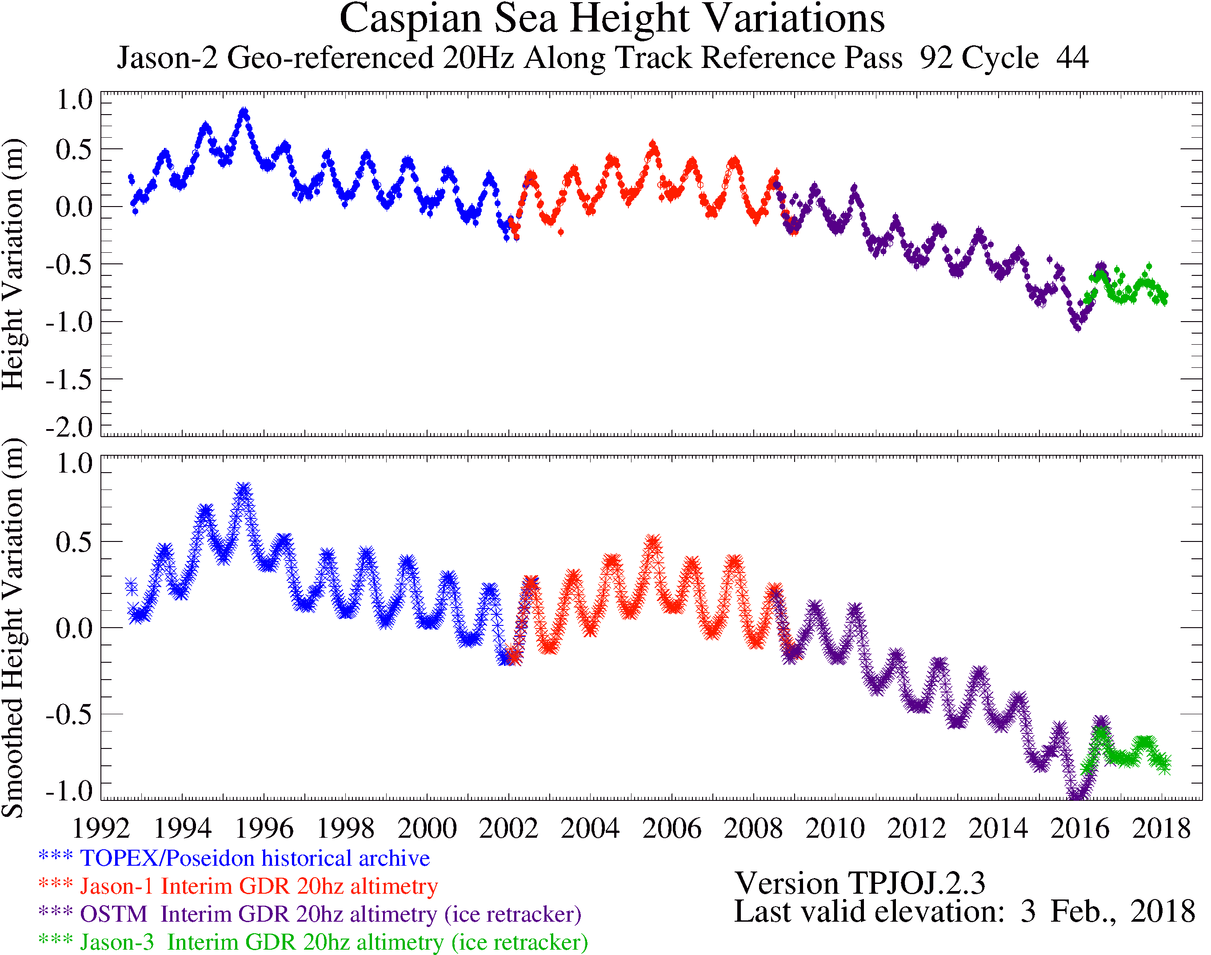
That was the highstand in 1995, but we didn’t know http://www.pecad.fas.usda.gov/cropexplorer/global_reservoir/gr_regional_chart.aspx?regionid=stans&reservoir_name=Caspian

Slide 10
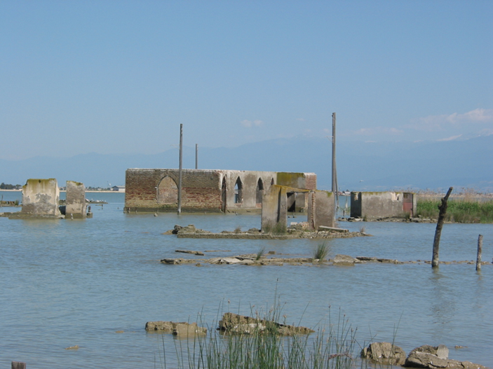
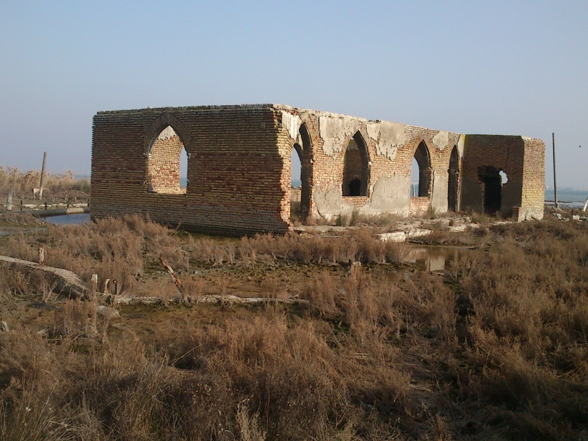
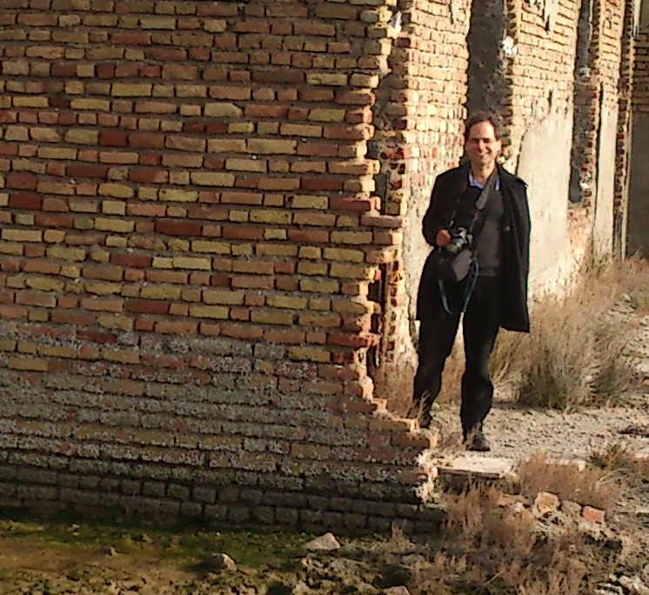
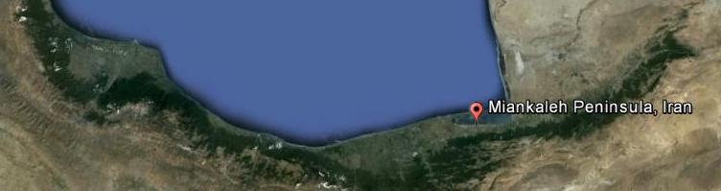
2005
2013
Mosque, Miankaleh Spit,, Caspian Sea, Iran
1995 highstand

Slide 11
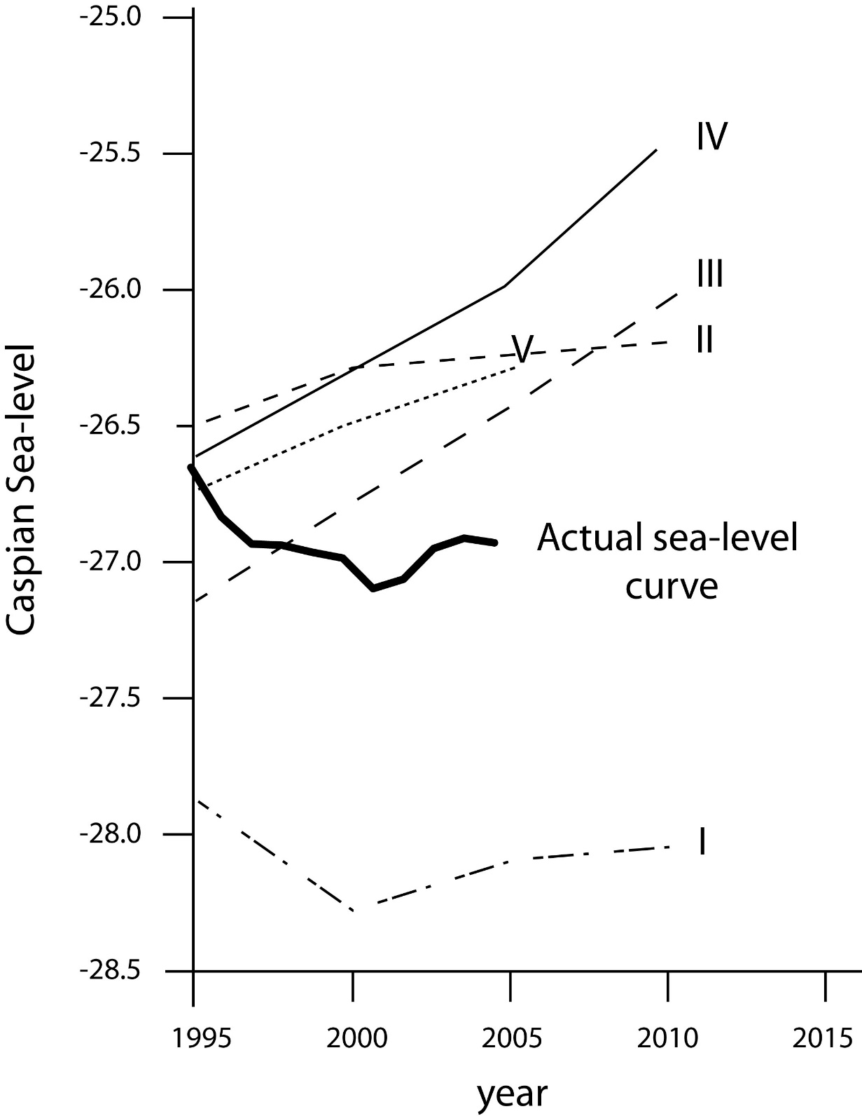
Predictions I-V in 1995 by Klige, Malinin, Duvanin, Rychagov, Budyko, Efimova, Naydyonov, Rodionov, Krenke and others,
and what really happened
After Meshcherskaya, 2005

Slide 12
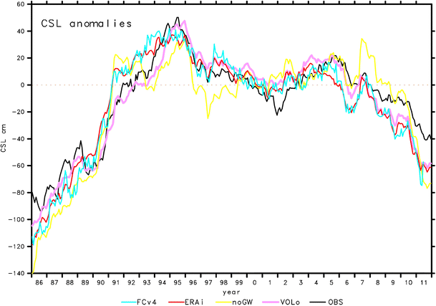
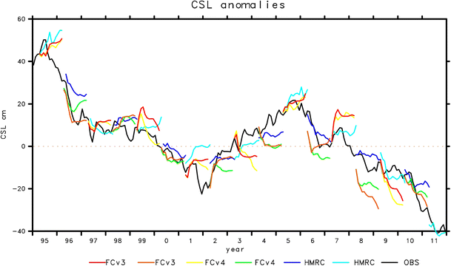
Good correlation CSL
with Volga discharge,
but what regulates
Volga discharge?
Arpe et al., 2013
CSL anomalies as observed (OBS) or forecast 1 year ahead by global climate models
HMRC and ECMWF
Arpe et al., 2013

Slide 13
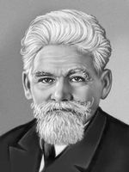
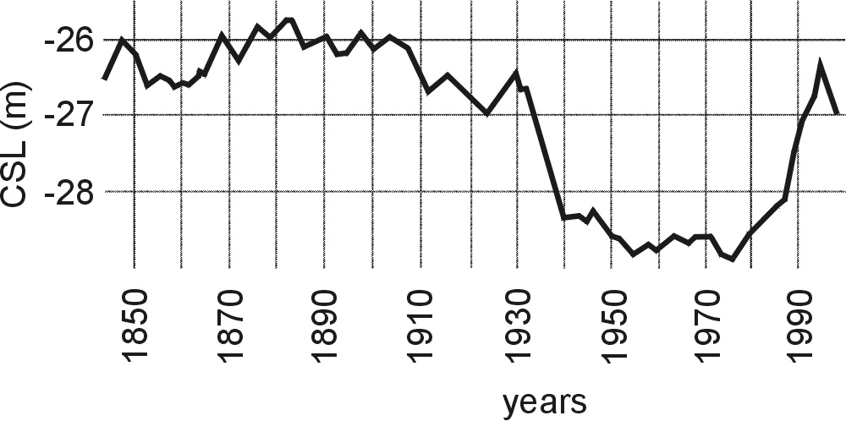
L.S. Berg (1934):
It is not probable that the level of the Caspian Sea will fall more than one metre below the 1925 level
https://upload.wikimedia.org/wikipedia/commons/5/55/Levberg.jpg
L.S. Berg (1950):
Is this the start of just the same process that in prehistory
led to 5 m sea level fall? Has it happened before in historical time?);
Lev Semyonovich Berg
(1876-1950)

Slide 14
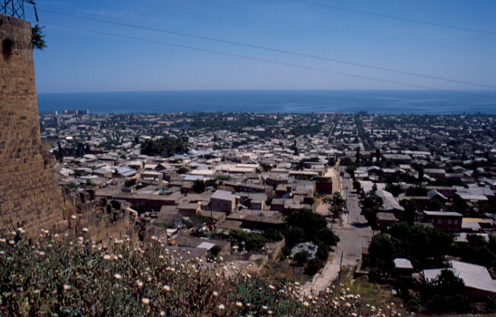
Derbent wall, 6th century CE, Dagestan, Russia: continues down to 8 m water depth

Slide 15
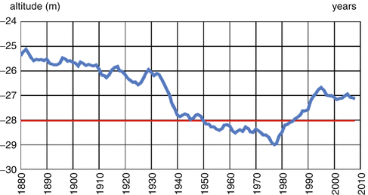
Caspian sea-level changes, 1880-2010
Three tipping points, none of them predicted

Slide 16
Time scales and amplitudes of rapid Caspian Sea level change
Seasonal changes (40 cm)
Historic sea-level cycle (1853-2000 AD, 3 m amplitude)
Centennial Late Holocene cycle (2600 - 300 BP) (>25 m amplitude)
Millennial cycle: Last Glacial- Early Holocene cycle (15,000-9,000 year BP)_ (>150 m amplitude)
Pliocene lowstand 5.5-3.4 Ma: Whole N and Mid Caspian dry >600 m?

Slide 17
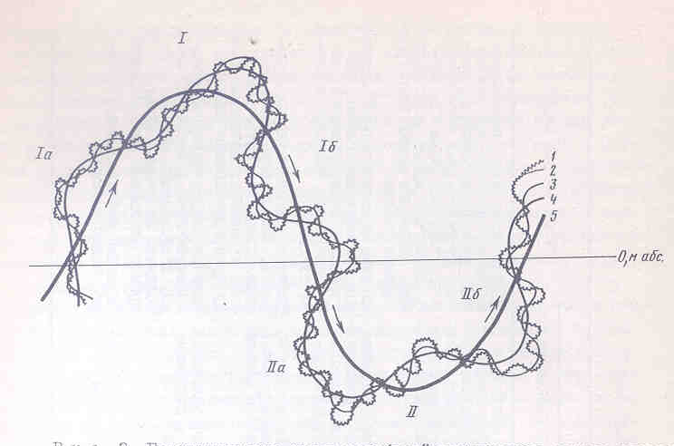
Schematic view of time scales and amplitudes of CSL change
Svitoch, 1991
Interference of different cyclicities in Caspian Sea Level Change

Slide 18
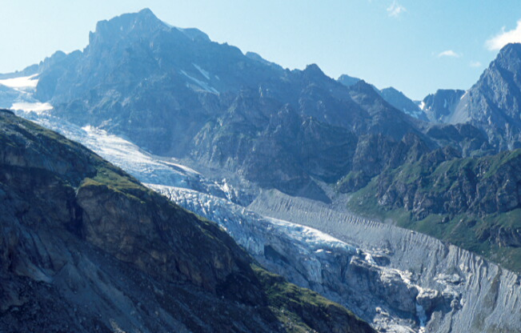
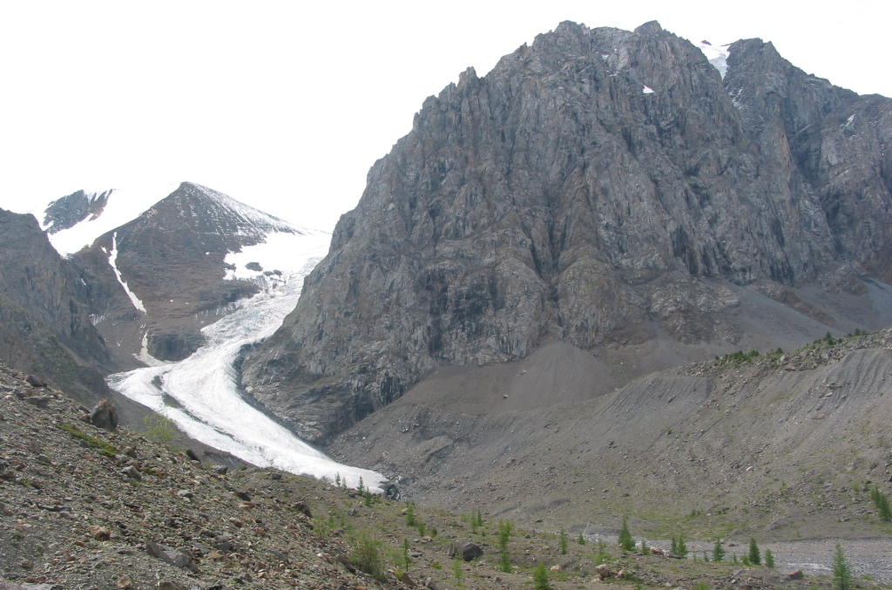
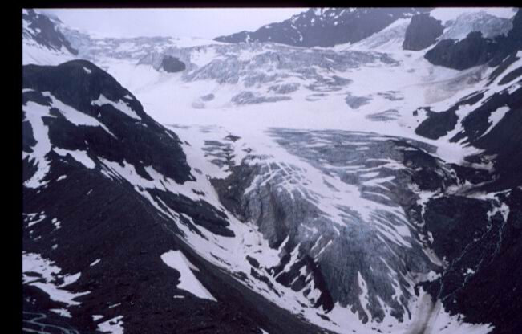
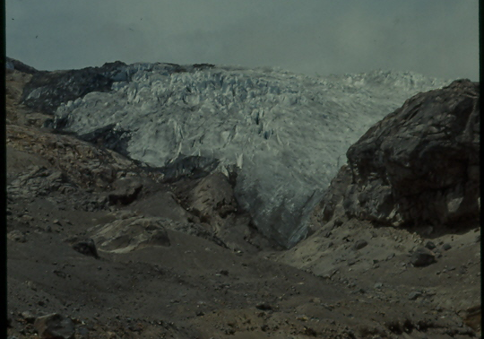
Schelda, Caucasus
AkTru, Altay, Siberia
Silvretta, Austria
Nevado del Ruiz, Colombia
Shrinking glaciers since Little Ice Age

Slide 19
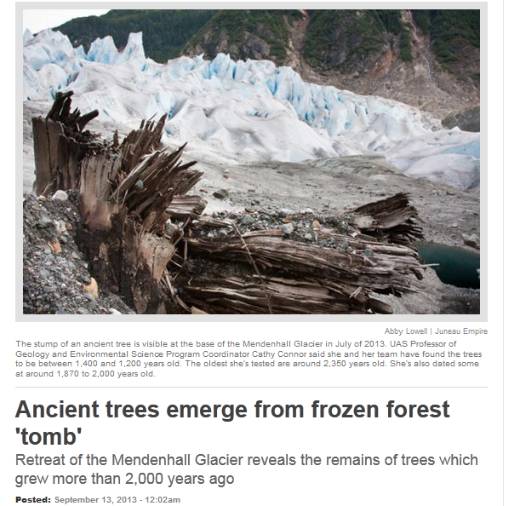

Slide 20
850 BP
Roman age
MWP
Little Ice Age
Holzhauser et al., 2005
More than 80 Alpine glaciers show Roman forest or peat remains

Slide 21
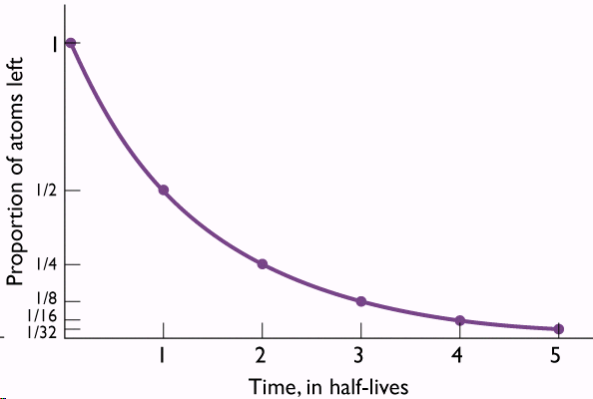
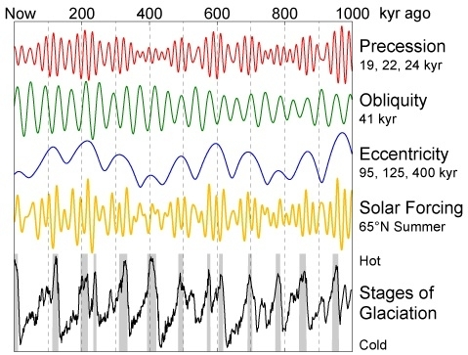
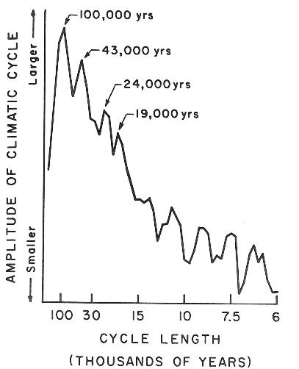
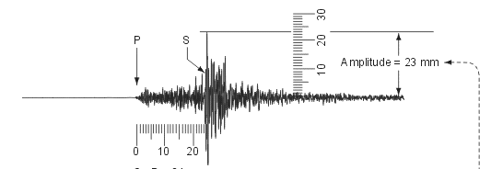
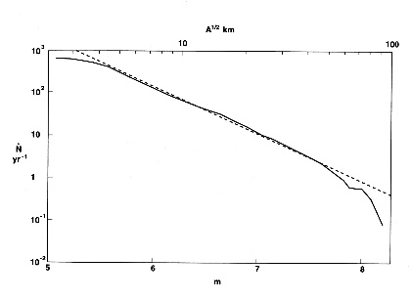
Time regimes of processes in nature
Time as an arrow
(radioactive decay, river flow)
Time as a cycle
(Milanković,
time scales)
Time as a pulse
(earthquake,
frequency/magnitude)

Slide 22
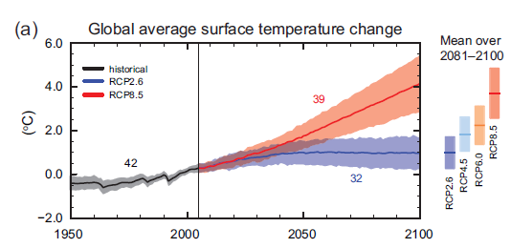
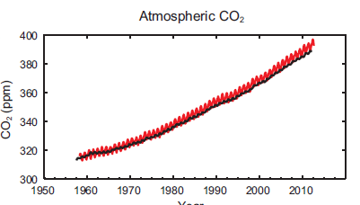
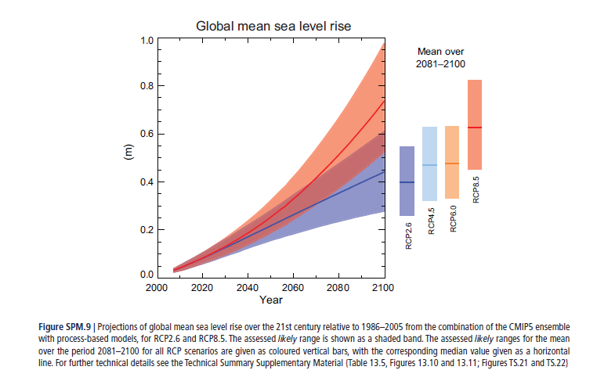
IPCC projects
rising temperature,
rising sea level
because of rising CO₂
Are these arrows?
Can we extrapolate
into the future?

Slide 23
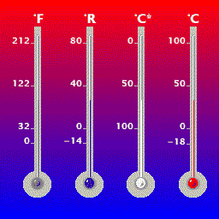
How do we know past temperatures?
(1) Instrumental measurements
Fahrenheit, Reaumur, Celsius (1742), Celsius now
Different scales, different ways of measuring, discontinuous records

Slide 24
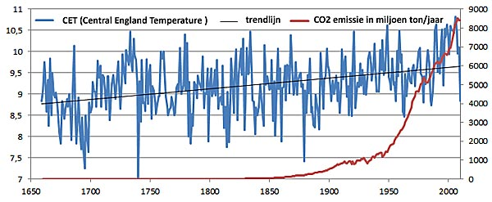
Continuous time series Central English Temperature since 1650:
CET Longest continuous instrumental temperature record
and CO₂ emissions
But no acceleration in temperature rise due to rising CO2
Data source: Hadley Centre, Earth Policy

Slide 25
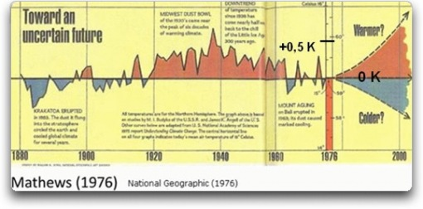
Global warming!
?
Public opinion:
Ice age is coming!
Temperature: also cycle, colder climate 1943-1976, but why?

Slide 26
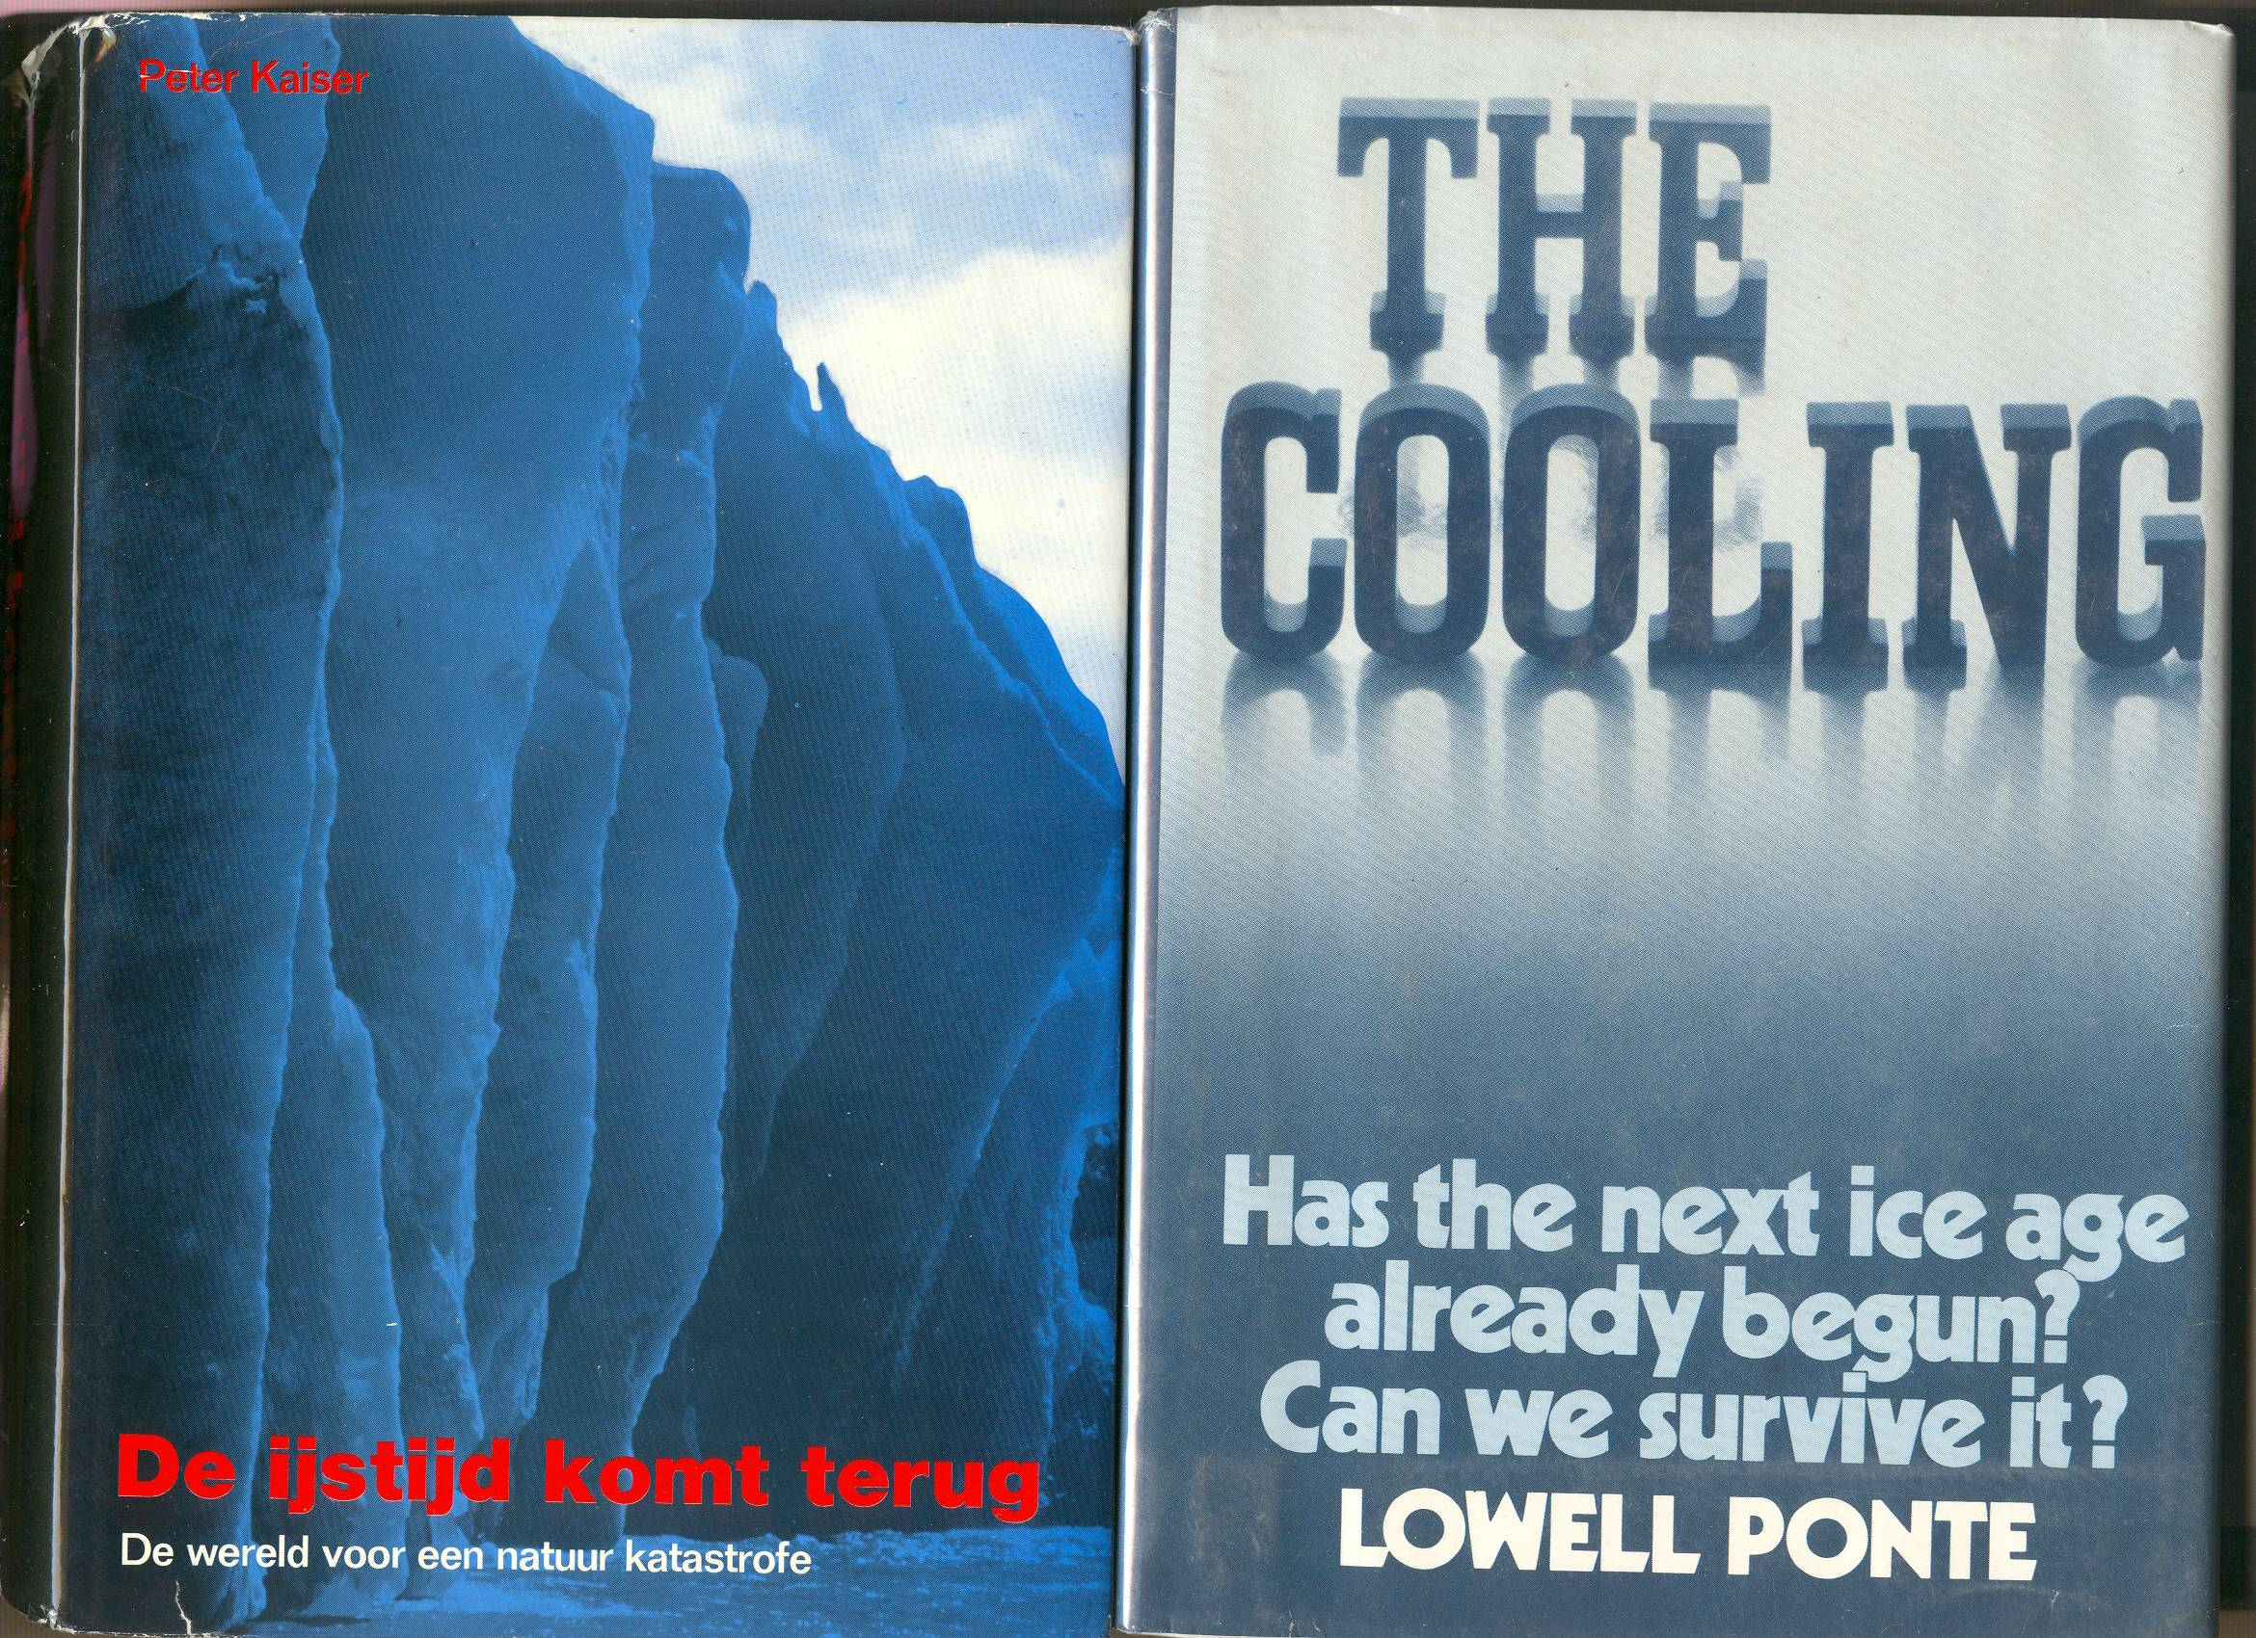
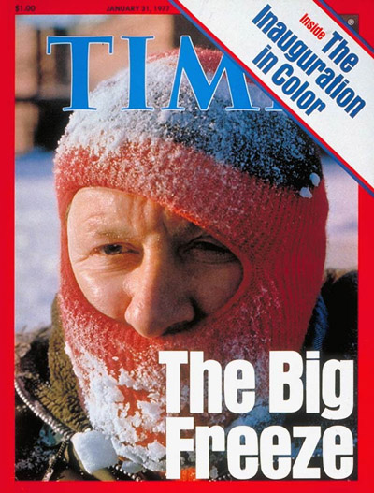
1972
1976
1976
1977
1972

Slide 27
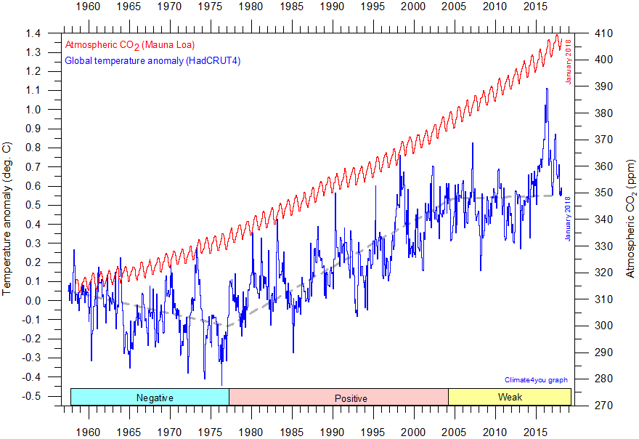
Global temperature anomaly and CO₂ since 1958:
arrow or cycles? Last updated Jan/2018 (Climate4you.com)

Slide 28
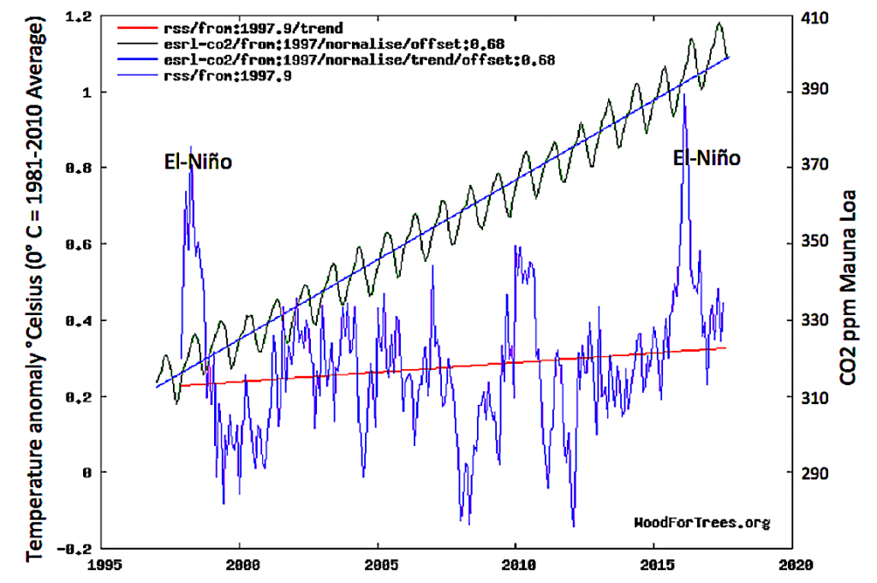
Same since 1995, with 2 El Niño ‘hot flushes’, but what triggers El Niño?

Slide 29
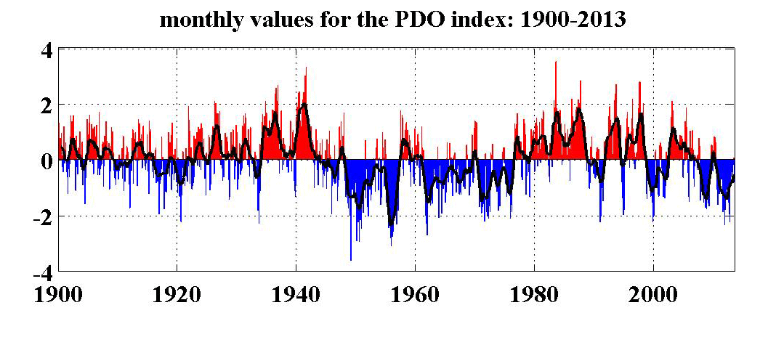
PDO Negative
PDO Positive Neg
El Niño
La Niña
Natural cycles in the Pacific: El Niño-La Niña (~5 years)
PDO (Pacific Decadal Oscillation), parallels T cycles
If we don’t know how it works, can we predict how it will behave in future?

Slide 30
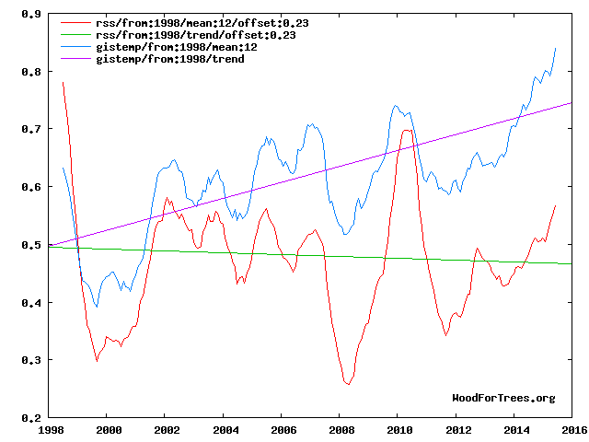
Land based
Satellite-based
Large differences between surface data and satellite temperatures

Slide 31
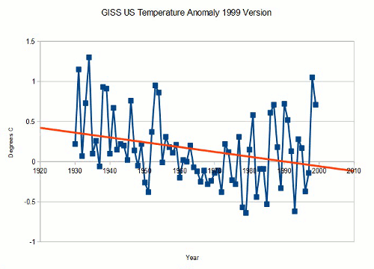
Harmonization problems

Slide 32
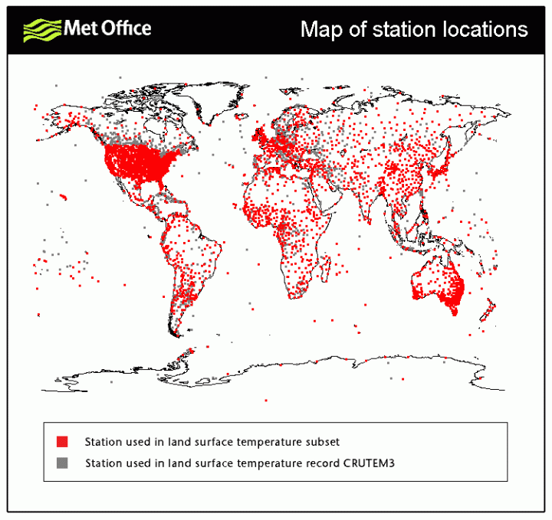
Irregular distribution of weather station on the globe: how to calculate global temperature?
British omit areas without data, Americans extrapolate from far-removed weather stations

Slide 33
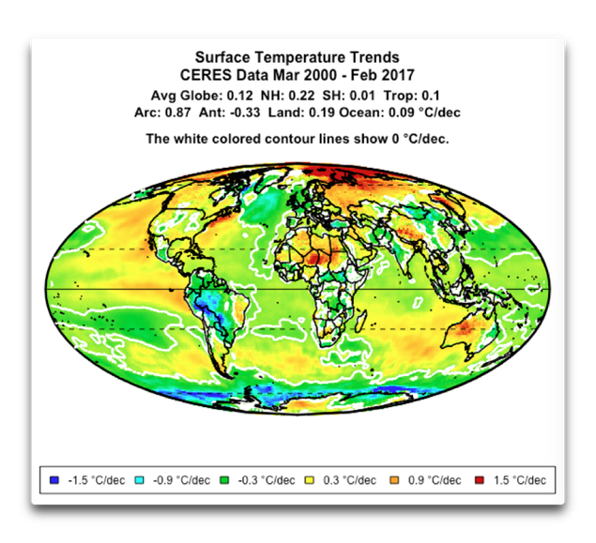
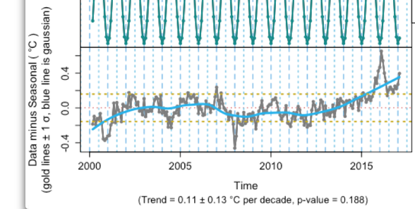
W. Eschenbach
Large regional differences in temperature trends 2000-2017
W. Eschenbach, 2018

Slide 34


W. Eschenbach
IPCC: best fit with natural+anthropogenic . Eschenbach: bogus model fits with only naturals
Attribution to causes by wiggle matching is difficult

Slide 35

(2) Reconstruction of past temperatures from proxy data

Slide 36





Tree rings
Arctica Islandica, 500 y old mollusc
Varves, annual glacial
sediment layers
Annual coral growth
Annual layering, Quelccaya Ice cap, Peru
Annual proxies

Slide 37



Wheat prices in Europe 1200-1900
Little Ice Age

Slide 38




Medieval Warm Period
Little Ice Age
Mann et al., 1998, IPCC 2001
McIntyre, McKitrick, 2003
“

Slide 39

Shaun Marcott’s hockey stick: not in thesis, only in Science paper

Slide 40

WUWT
Medieval Warm Period global data: red= warm, blue = cold, yellow= dry, green= wet

Slide 41

Climate projections based on Solar activity: next Little Ice Age
Attribution problem: Is there a relation with sunspot activity? Unproven

Slide 42

IPCC people say
it will get warmer
Solar people say: it will get colder, we are
heading for another Little Ice Age
Remember 1976!

Slide 43

Wikimedia
The best we’ve already had:Holocene Climate optimum, 6000 BP

Slide 44



Proxy data (oxygen isotopes in deep sea and ice cores)
reveal still longer cycles: what do they mean?
Fourier analysis

Slide 45


Slide 46


Slide 47




Slide 48


Slide 49


Slide 50

The Earth 250 million years from now: Greenland desert again?

