Slide 1

BMS-ANed General Assembly 2026
Leiden, 19 June 2026, 13:00h-13:30h

Slide 2
Agenda
1. Opening
2. Approval of the agenda
3. Minutes ALV 19/06/2025
4. Overview BMS-ANed events, June 2025-June 2026
5. Changes in BMS-ANed board
6. Financial overview + report financial audit
7. Budget 2026
8. Registry biostatisticians
9. Any other business
10. Closing

Slide 3
Hans van Houwelingen
On 14 May 2026, Hans van Houwelingen passed away. Hans had been an honorary member of VVSOR since 2008 and was closely connected to our section.
An in memoriam has been published on the VVSOR website and will also appear in STAtOR.
Hans made an enormous contribution to the development of biostatistics
in the Netherlands.
Symposium in Memory of Hans van Houwelingen.

Slide 4
Overview BMS-ANed events (2025-2026)
PhD day: Beyond math (20th November 2025)
Location: RadboudUMC Nijmegen
SPEAKERS
– Richard Bartels
– Rogier Donders
– Dimitris Rizopoulos
– Lauke Stoel
– Sixu Cai
30 participants

Slide 5
Overview BMS-ANed events (2025-2026)
ONLINE SEMINARS
i) June 2025: Wessel van Wieringen (Department Epidemiology and Data Science, Amsterdam UMC; Department of Mathematics, VU) – “Regularization: essentials, connections, and applications”
ii) November 2025: Jonathan Bartlett (School of Hygiene & Tropical Medicine) – “G-formula for causal inference using synthetic multiple imputation”
iii) March 2025: Alicia Curth (Microsoft Research Cambridge) – “Demystifying Double Descent, Benign Overfitting and Other Surprises Surrounding the Bias-Variance Tradeoff”
iiii) May 2026: Edouard Bonneville (Ludwig-Maximilians-Universität München) – “Missing covariates in survival models”
45 participants

Slide 6
Overview BMS-ANed events (2025-2026)
TODAY: Survival analysis meets infectious disease modeling
BMS-Aned is sponsor

Slide 7
Upcoming event
Hans van Houwelingen Award 2026
When: November 2026
Location: Leiden
Symposium in honor of the winning paper: ‘Cluster extent inference revisited: quantification and localization of brain activity’ by Jelle Goeman et al.
Further details will follow

Slide 8
Changes in BMS-ANed board
Farewell
Mar Rodríguez-Girondo (LUMC). Floor van Oudenhoven (Danone Nutricia Research) is new secretary.
New board member
Liesbeth de Wreede (LUMC)

Slide 9
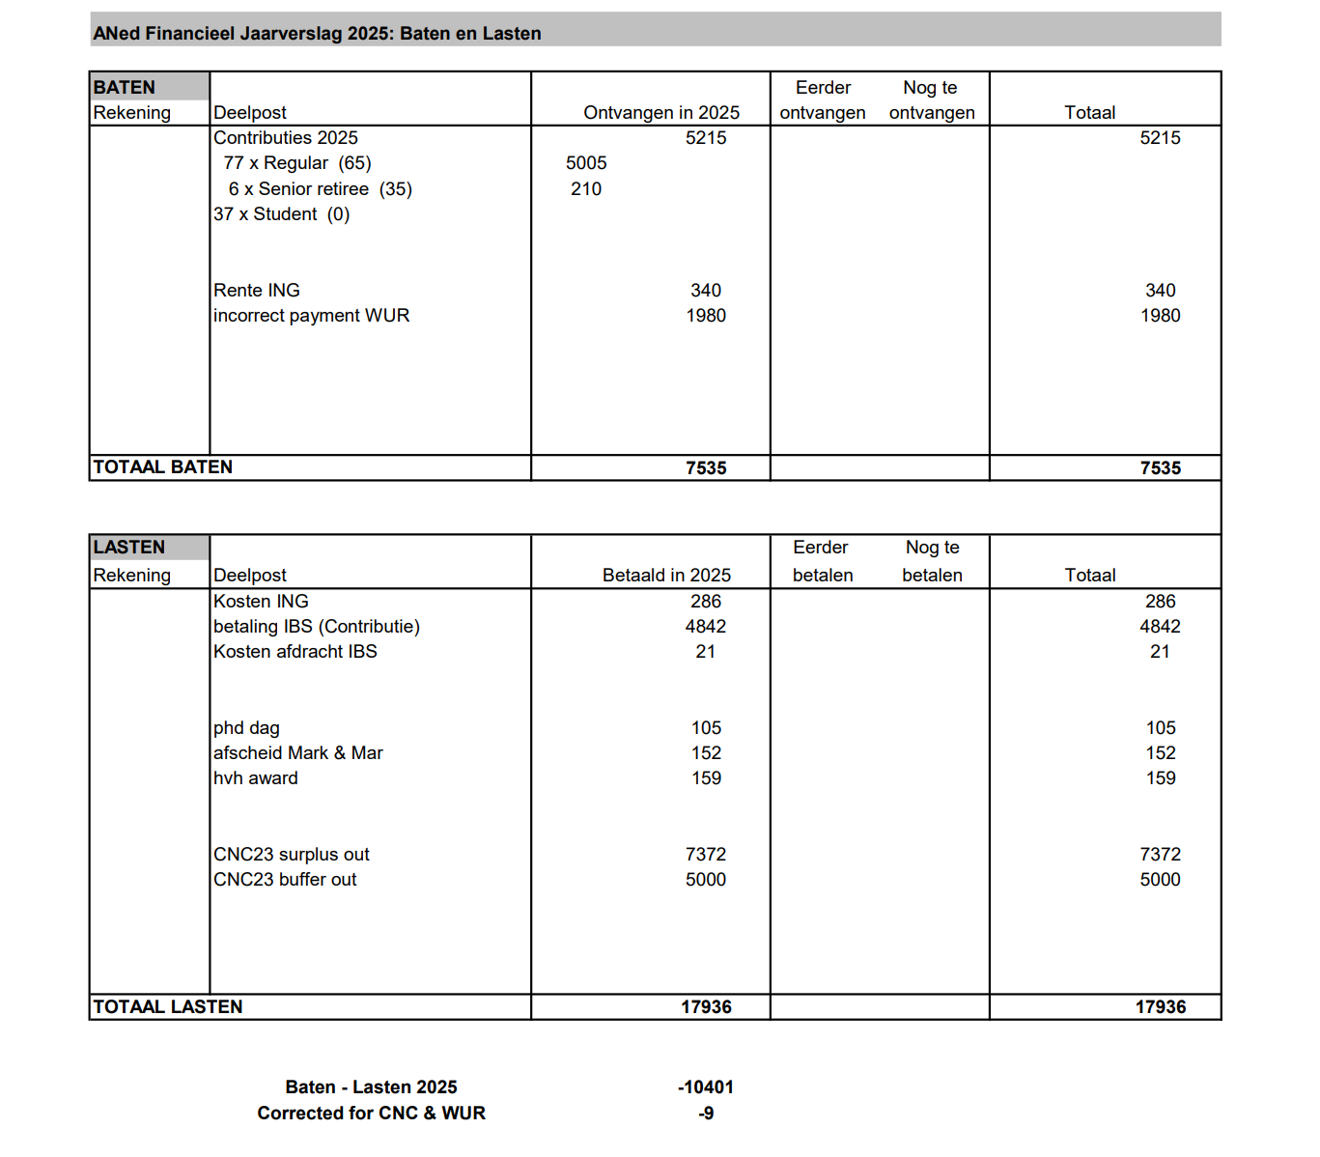
Finances

Slide 10
Membership count

Slide 11
Budget 2026
Activity | Expected | Comment
fees IBS | 0 to 100 | close to budget neutral
workshop Amsterdam | -594 | sponsoring borrel
meeting Leiden | -750 | borrel
meeting 2nd part 2025 | -200 to 0 | mostly covered by vvsor
goodbye, gifts, etc | -100 to -200 | small items
 | -1544
deficit covered by CNC2023

Slide 12
Registry Biostatisticians
Registry Biostatisticians is now live: Certification - VVSOR
Open for applications
Board of the Registration committee:
Joost van Rosmalen (UMC Utrecht)
Joanna in ‘t Hout (Radboud UMC)
Peter van de Ven (UMC Utrecht)
Sophie Swinkels (Danone)

